Slide 1
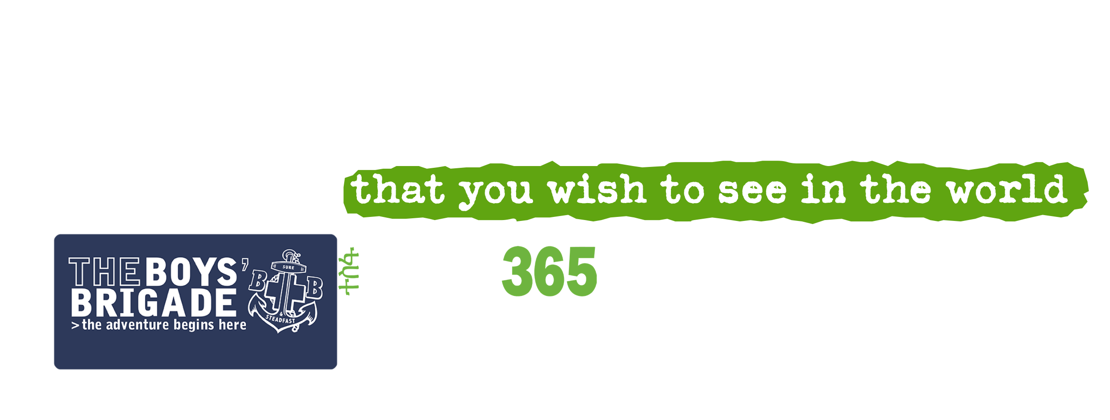

Slide 2
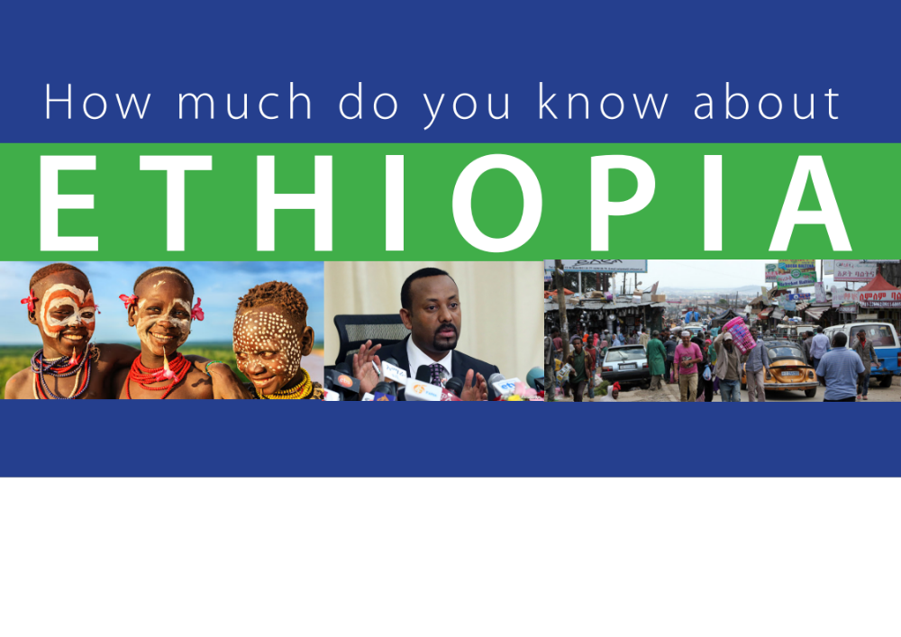

Slide 3

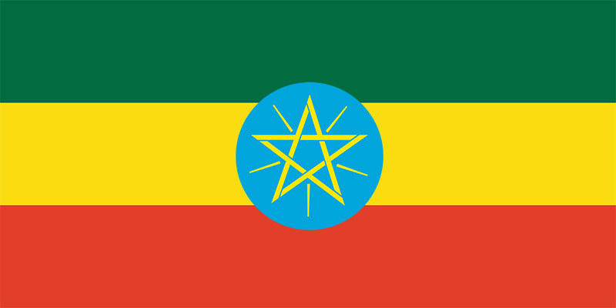
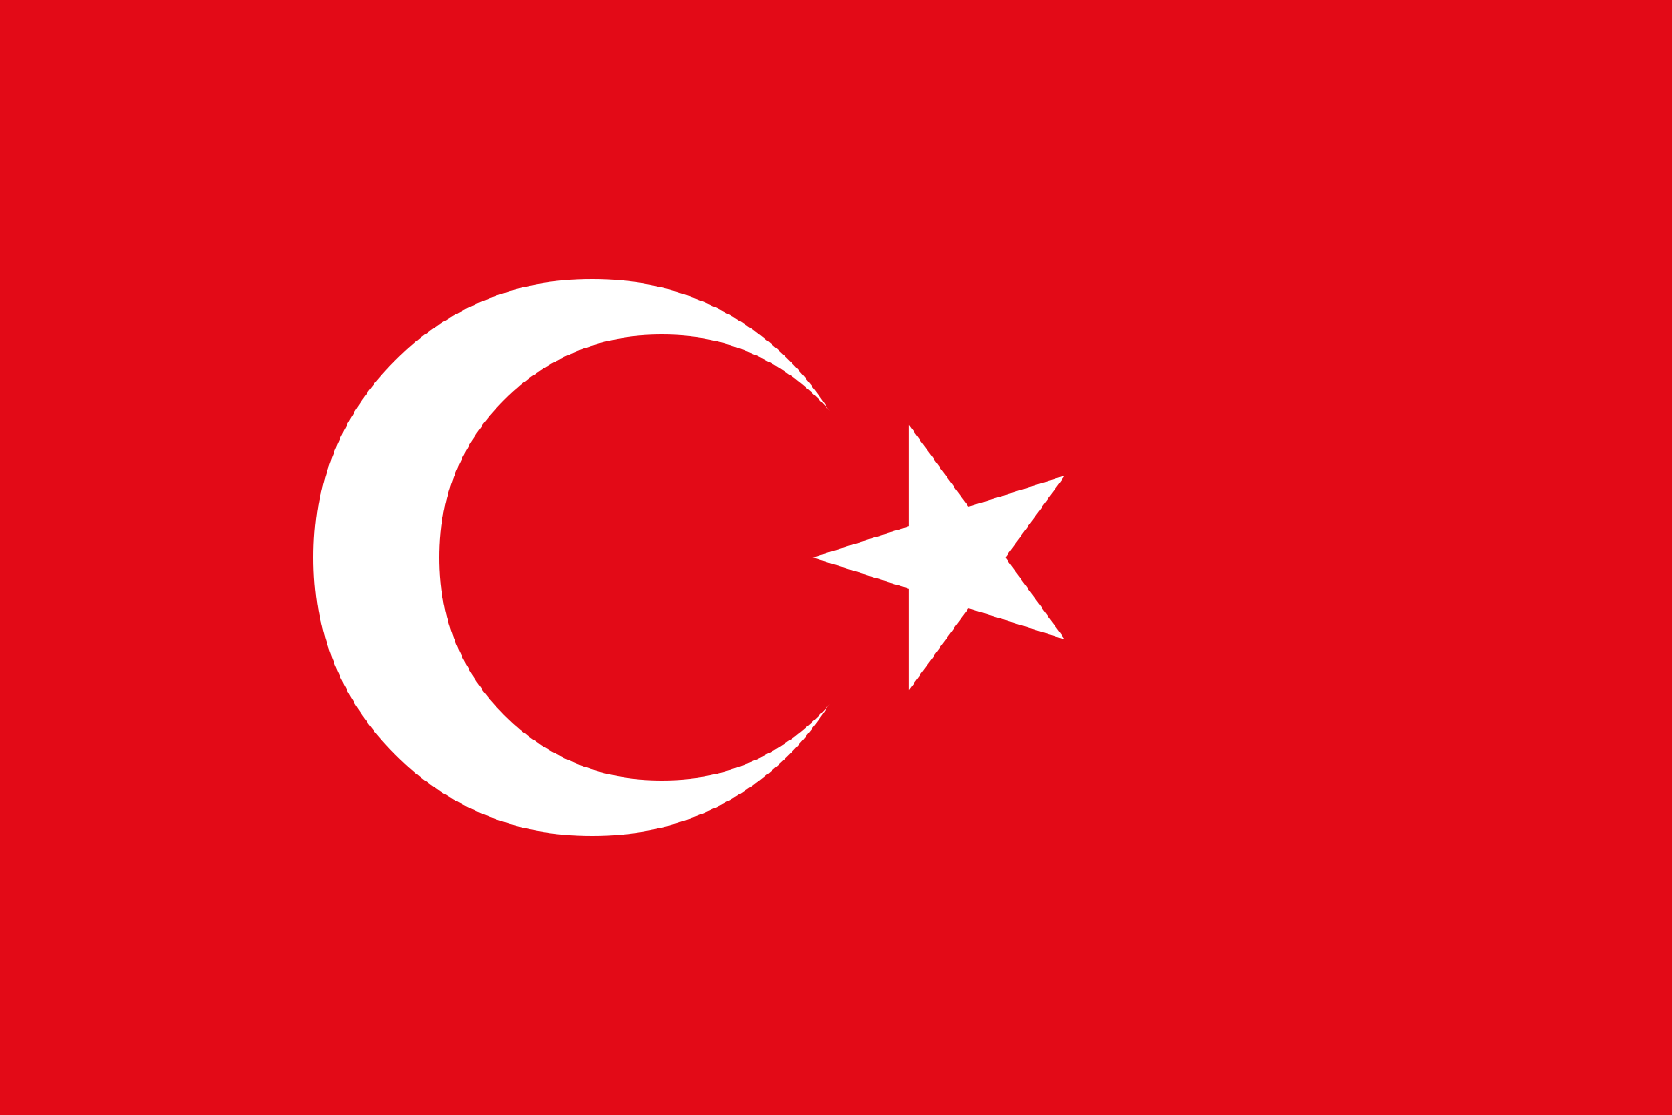
Q1. Which is the flag of Ethiopia?
A
B
C

Slide 4
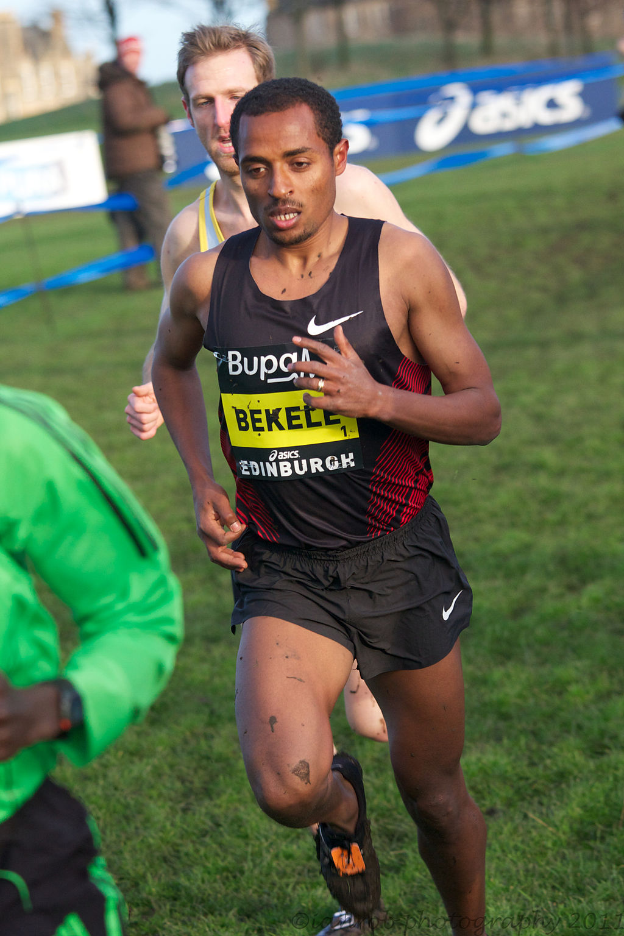
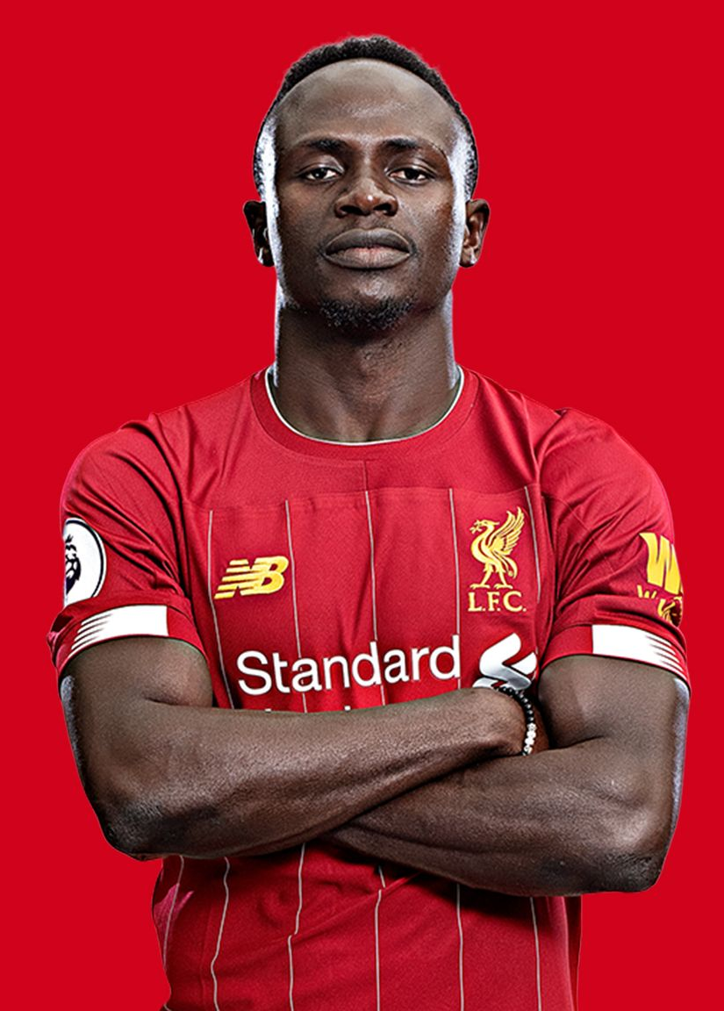
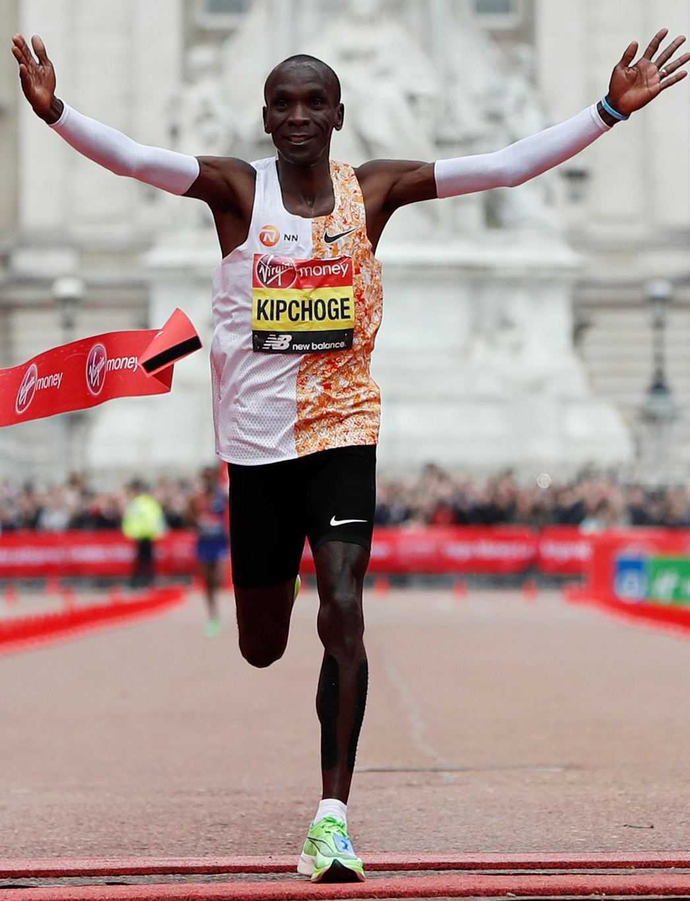
Q.2 Which one of these is a famous Ethiopian?
A
B
C
KENENISA BEKELE
SADIO MANE
ELIUD KIPCHOGE

Slide 5
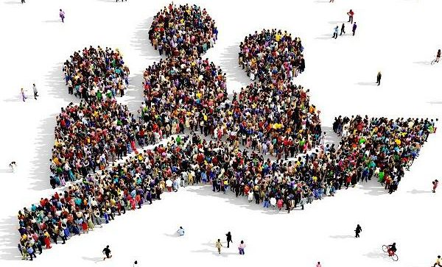
Q.3 What is the population of Ethiopia?
A. 11 Million
B. 55 Million
C. 110 Million

Slide 6
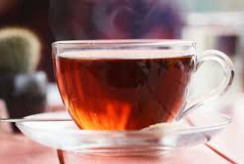
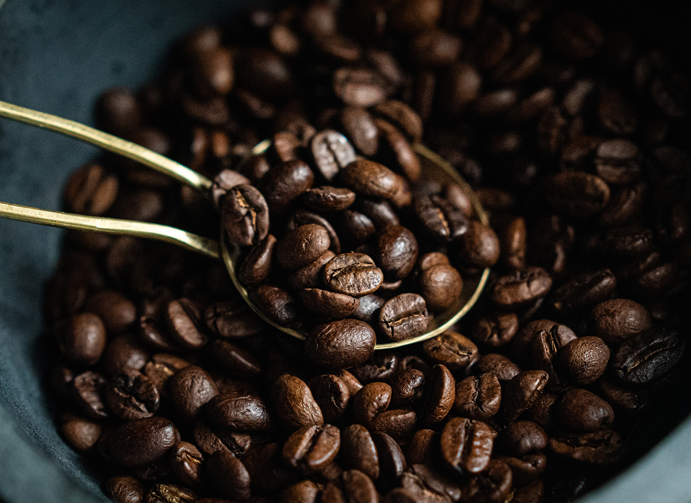
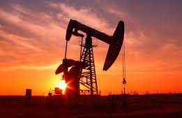
Q.4 What is the major export of Ethiopian?
A
B
C
Tea
Coffee
Oil

Slide 7
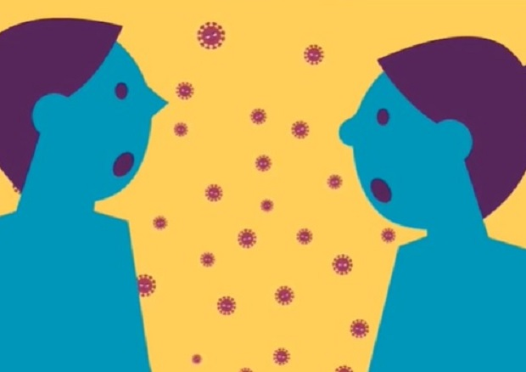
Q.5 How many languages are spoken in Ethiopia?
A. 8
B. 28
C. 88

Slide 8
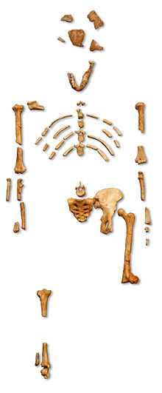
Q6. The oldest collection of fossilised bones (from 3.2 million years ago) that once made up the skeleton of a hominid were found in Ethiopia.
What name was given to “her”
A. Lucy
B. Anna
C. Twiggy
.

Slide 9
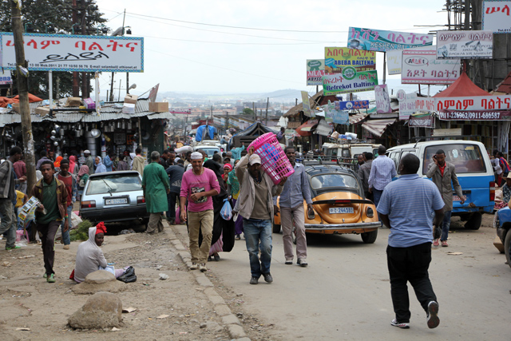
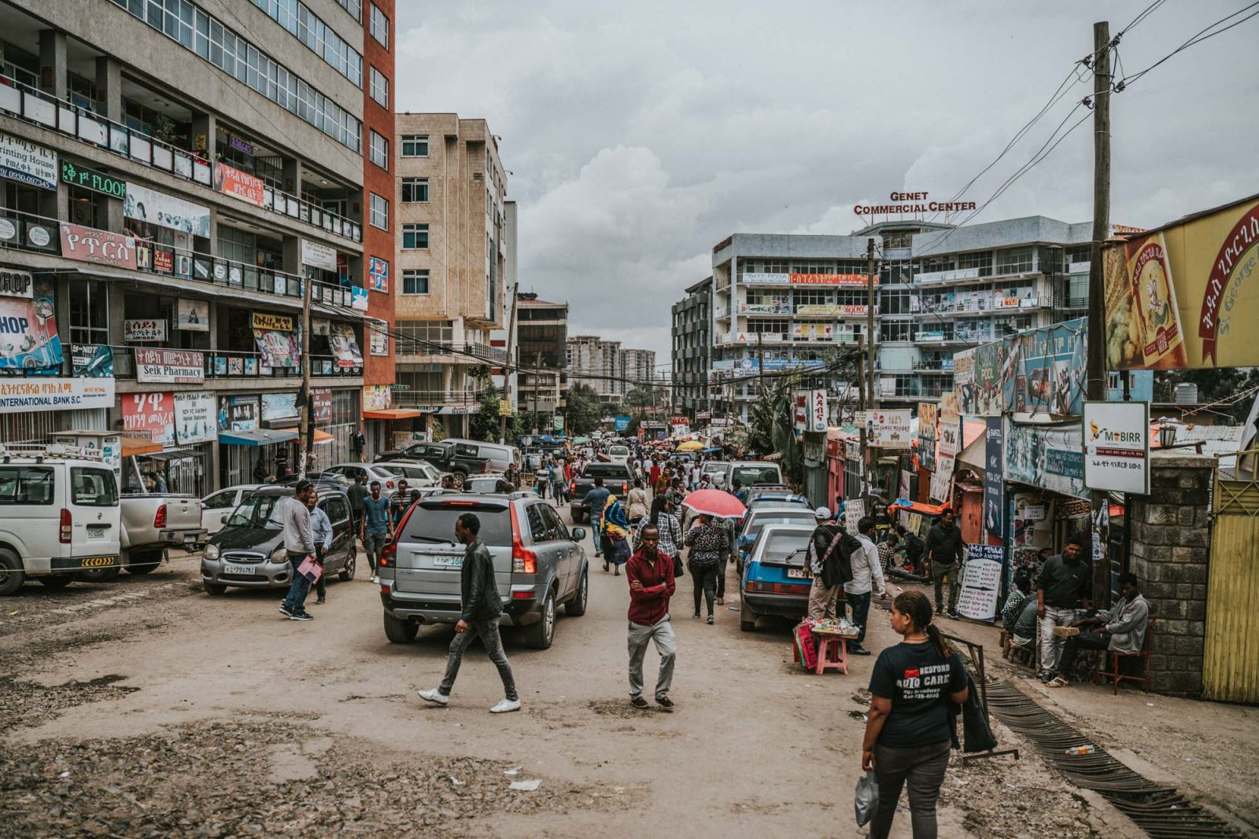
Q.7 What is the capital city of Ethiopia?
A
B
C
Addis Ababa
Nairobi
Cairo

Slide 10

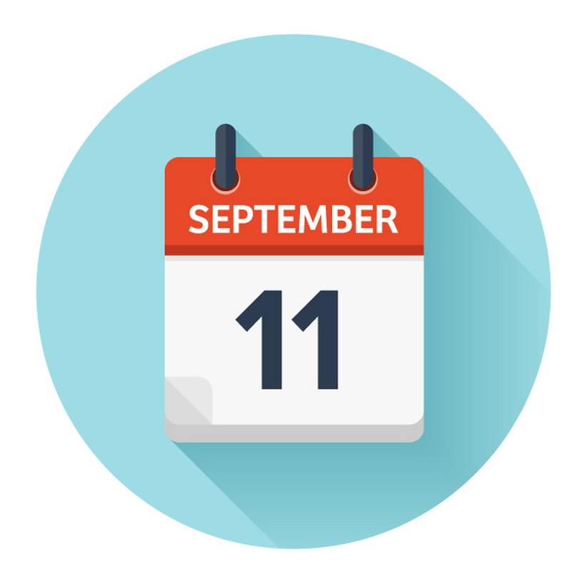

Q.8 When is New Years Day in Ethiopian?
A
B
C
Coffee
Oil

Slide 11

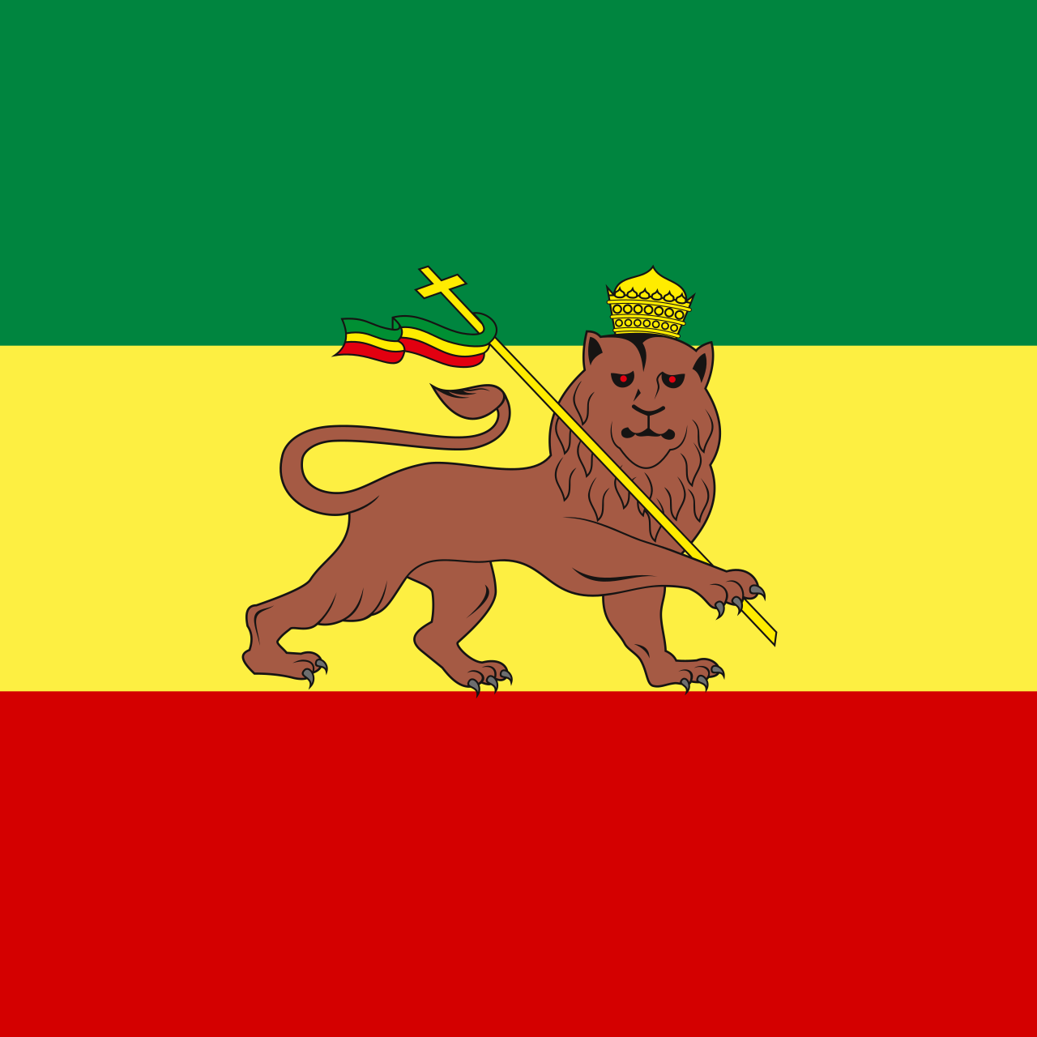

Q.9 An Ethiopian Emperor inspired which religion?
A
Hare Krishna
B
Rastafarian
C
Baha’i
Coffee

Slide 12
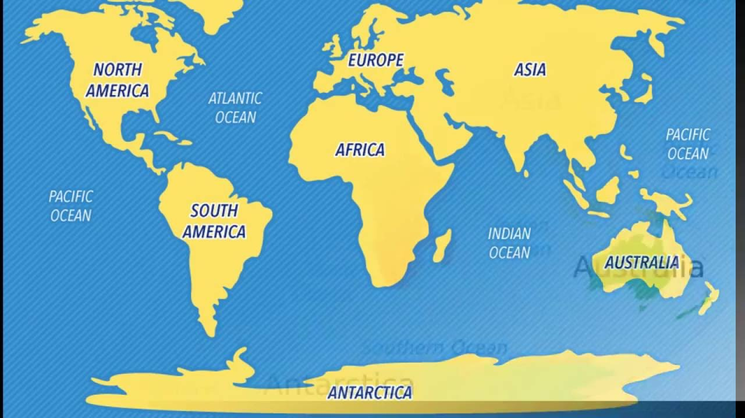
Q.10 Ethiopia is a big country – How many Northern Irelands would fit into Ethiopia?
A
Rastafarian
C
Baha’i
30
50
70

Slide 13
QUIZ ANSWERS on next slide

Slide 14
QUIZ ANSWERS
Q1 Answer B
Q2 Answer A – Kenenisa Bekele
Q3 Answer C – 110 million
Q4 Answer B – Coffee
Q5 Answer C – 88 languages
Q6 Answer A – Lucy
Q7 Answer A – Addis Ababa
Q8 Answer B – 11 September
Q9 Answer B – Rastafarian
Q10 Answer C - 70 x N.I.

