Slide 1
Anchors Taster Programme - Week 2
_________________________________________________________
If you have not already downloaded and installed the Brigade fonts used in this presentation you can download our font pack at
http://leaders.boys-brigade.org.uk/ourbrand.htm
Alternatively you may just need to check through the presentation to ensure the substitute font used is displaying correctly.
_________________________________________________________
All elements of the programme that need to be shown on screen are included in this presentation. Please remove any elements you do not need. This PowerPoint presentation will have any videos mentioned in the programme embedded into it. When you come to these click the play button to start the video. Ensure when sharing your screen through Zoom you tick the ‘Share Computer Sound’ box.
_________________________________________________________
Please check through and edit text as required. Remember to encourage parents/carers to send in photos of their child taking part in the ‘Takeaway Challenge’ and add these in on the ‘Last week’s challenge slide’. The young people will love seeing themselves here ☺
A template points chart is also included which you can update each week and share as part of your virtual session.

Slide 2


Slide 3

Last week’s challenge . . .
Add photos sent in by parents/carers here!

Slide 4

Remember to share your photos with us
Send by email to xxxxxxx or via WhatsApp/SMS/Social Media

Slide 5
#BBatHOME Points Chart
Copy and paste your latest points chart from previous week!
We will update points each week and share on our Virtual Sessions!
Medals will be awarded as follows:
Bronze = 10+ Points / Silver = 20+ Points / Gold = 35+ Points / Diamond = 50+ Points / Platinum = 75+ Points

Slide 6

Animal Bingo

Slide 7

Rhino

Slide 8

Racoon

Slide 9

Fox

Slide 10

Horse

Slide 11

Panda

Slide 12

Elephant

Slide 13

Stag

Slide 14

Giraffe

Slide 15

Gorilla

Slide 16

Snake

Slide 17

Zebra

Slide 18

Bear

Slide 19

Hedgehog

Slide 20

Penguin

Slide 21

Lion

Slide 22

Tiger

Slide 23

Kangaroo

Slide 24

Camel

Slide 25

Hippo

Slide 26

Crocodile

Slide 27

Seal

Slide 28

Rabbit

Slide 29

Wolf

Slide 30

Tortoise

Slide 32
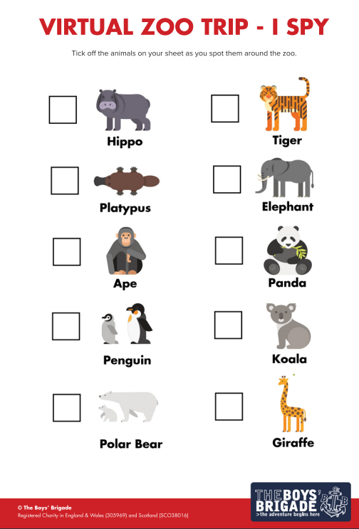
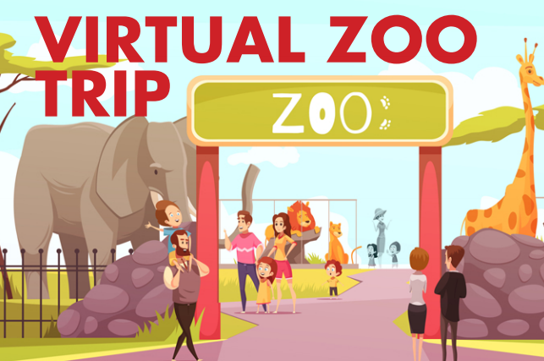
Have you got your ‘I SPY’ sheet ready?
Which animal shall
we visit first?

Slide 33
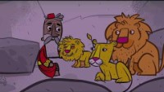

Slide 34

Guess the Animal Noise

Slide 35
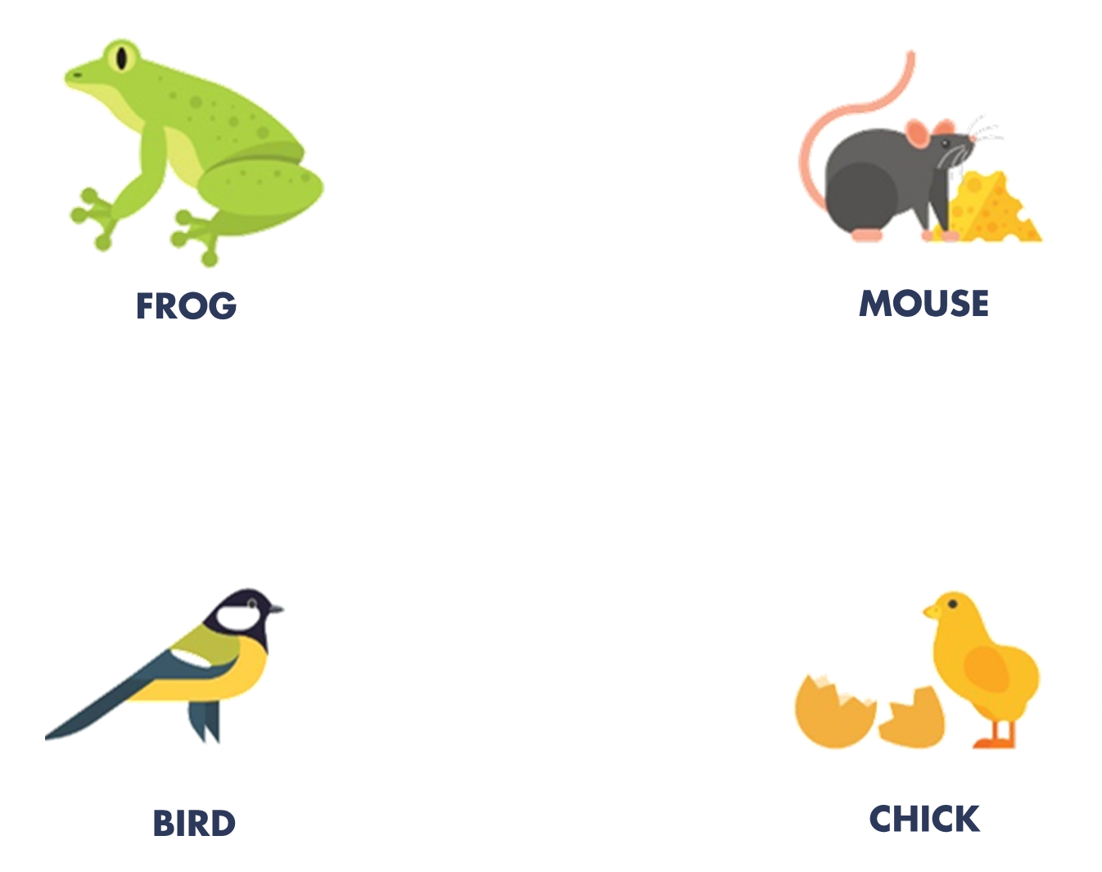


Slide 36
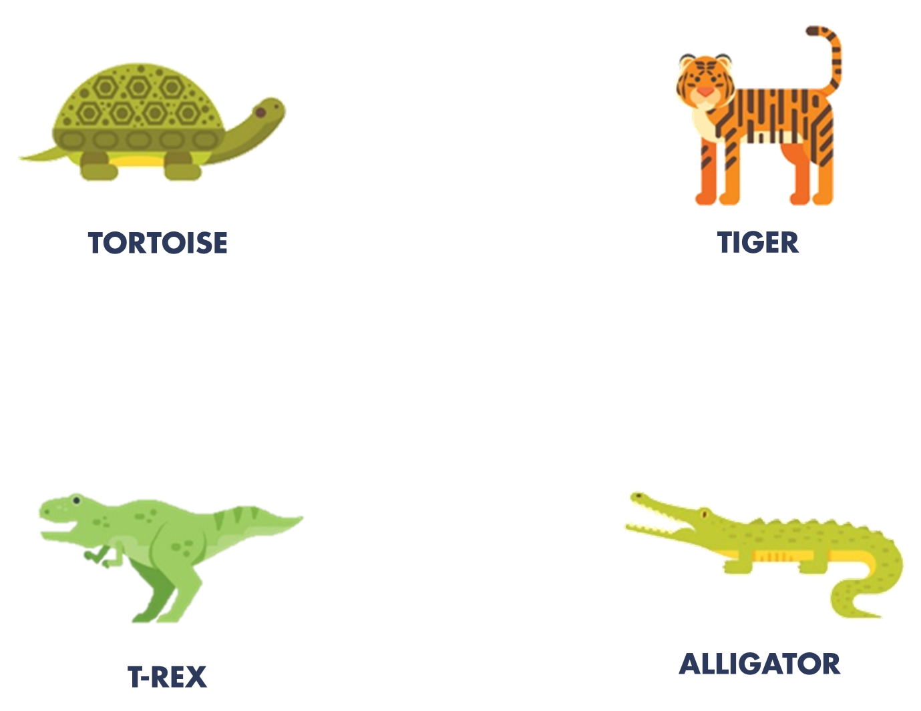

Slide 37
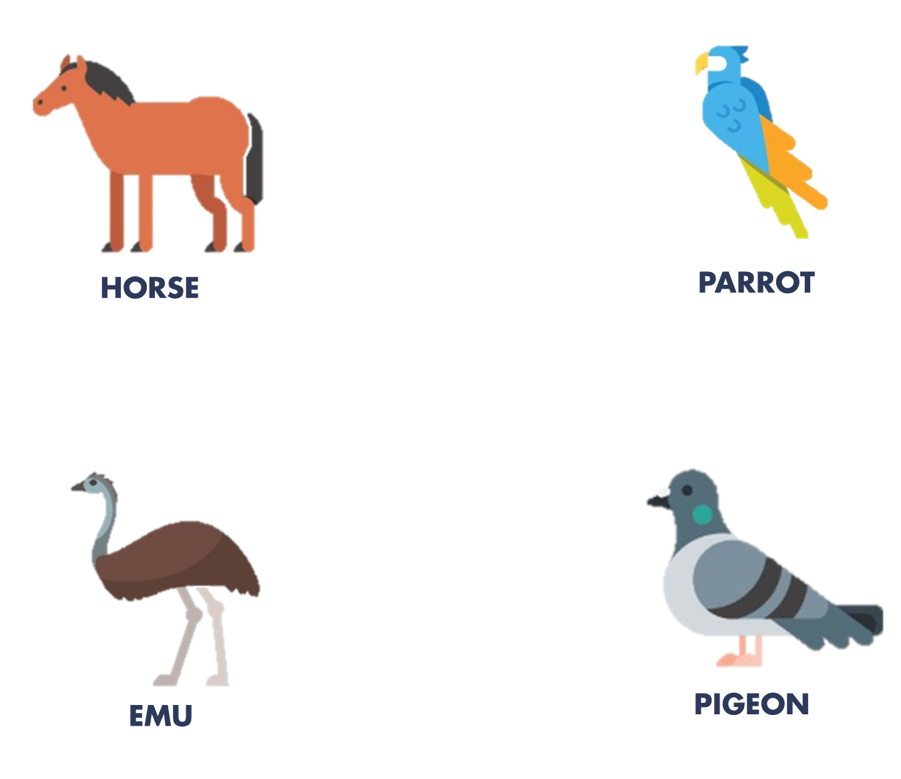

Slide 38
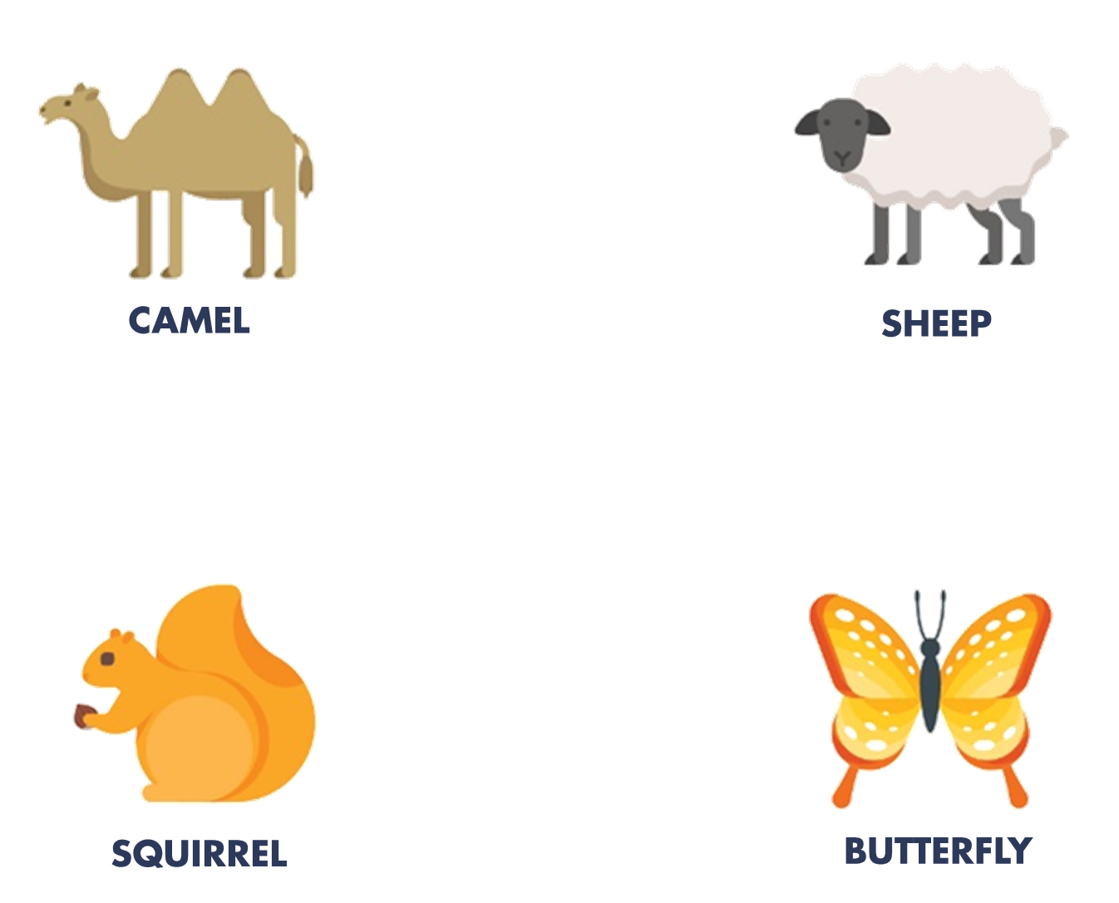

Slide 39
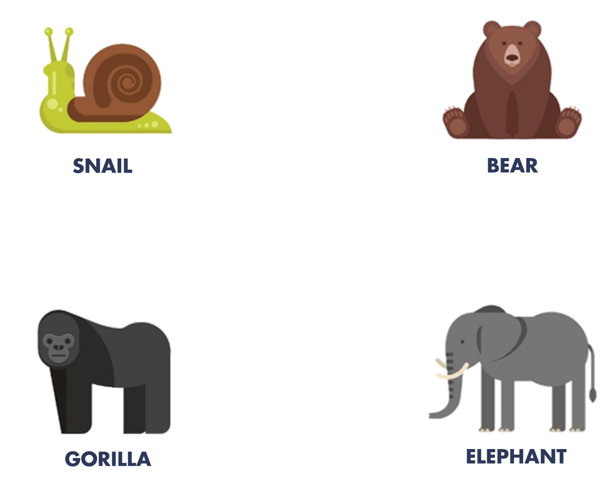

Slide 40


Slide 41
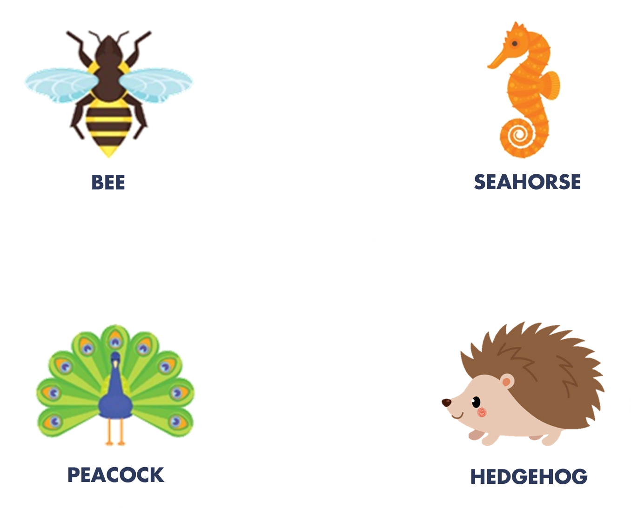

Slide 42
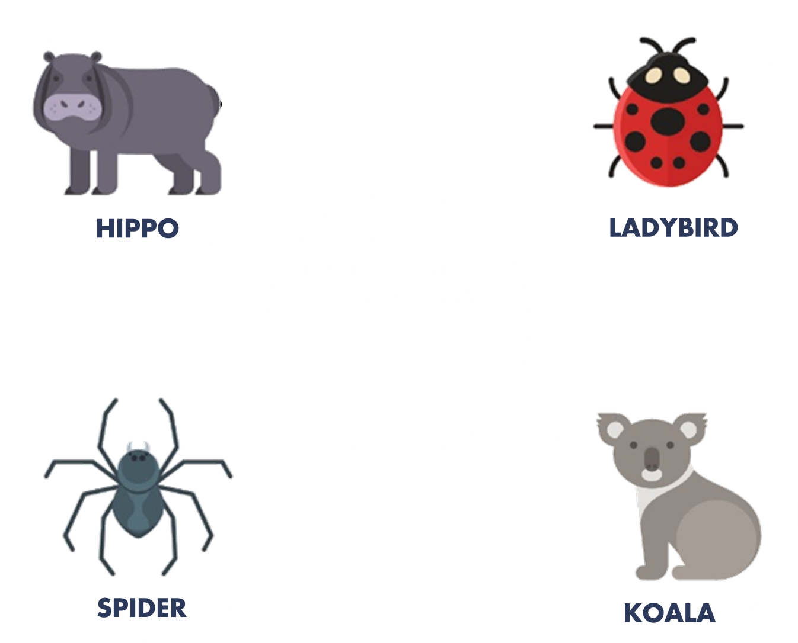

Slide 43
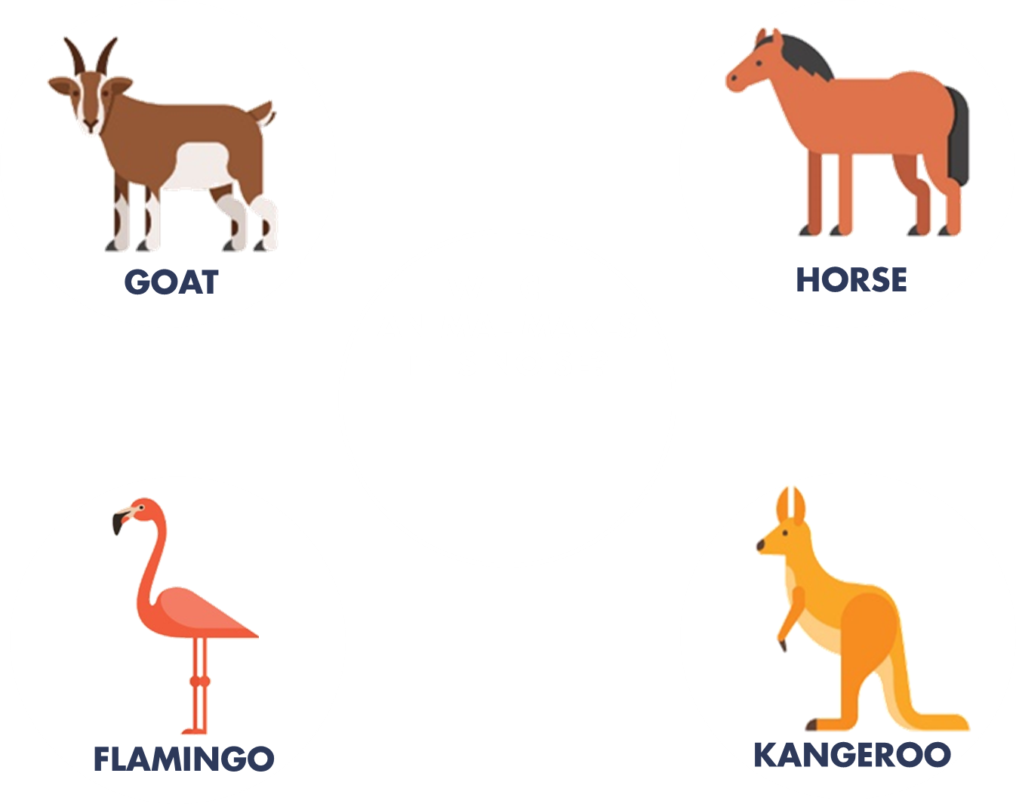

Slide 44
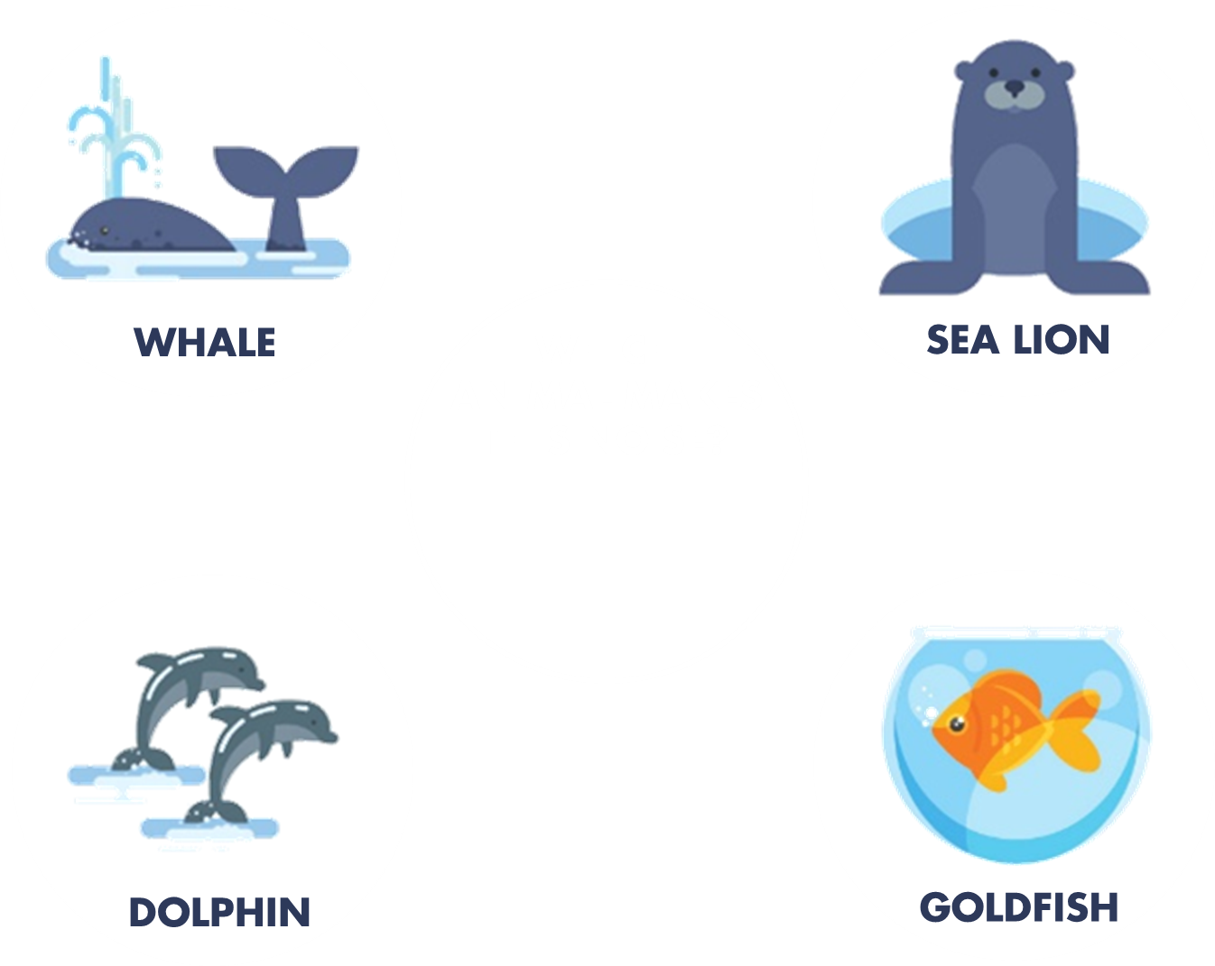

Slide 45
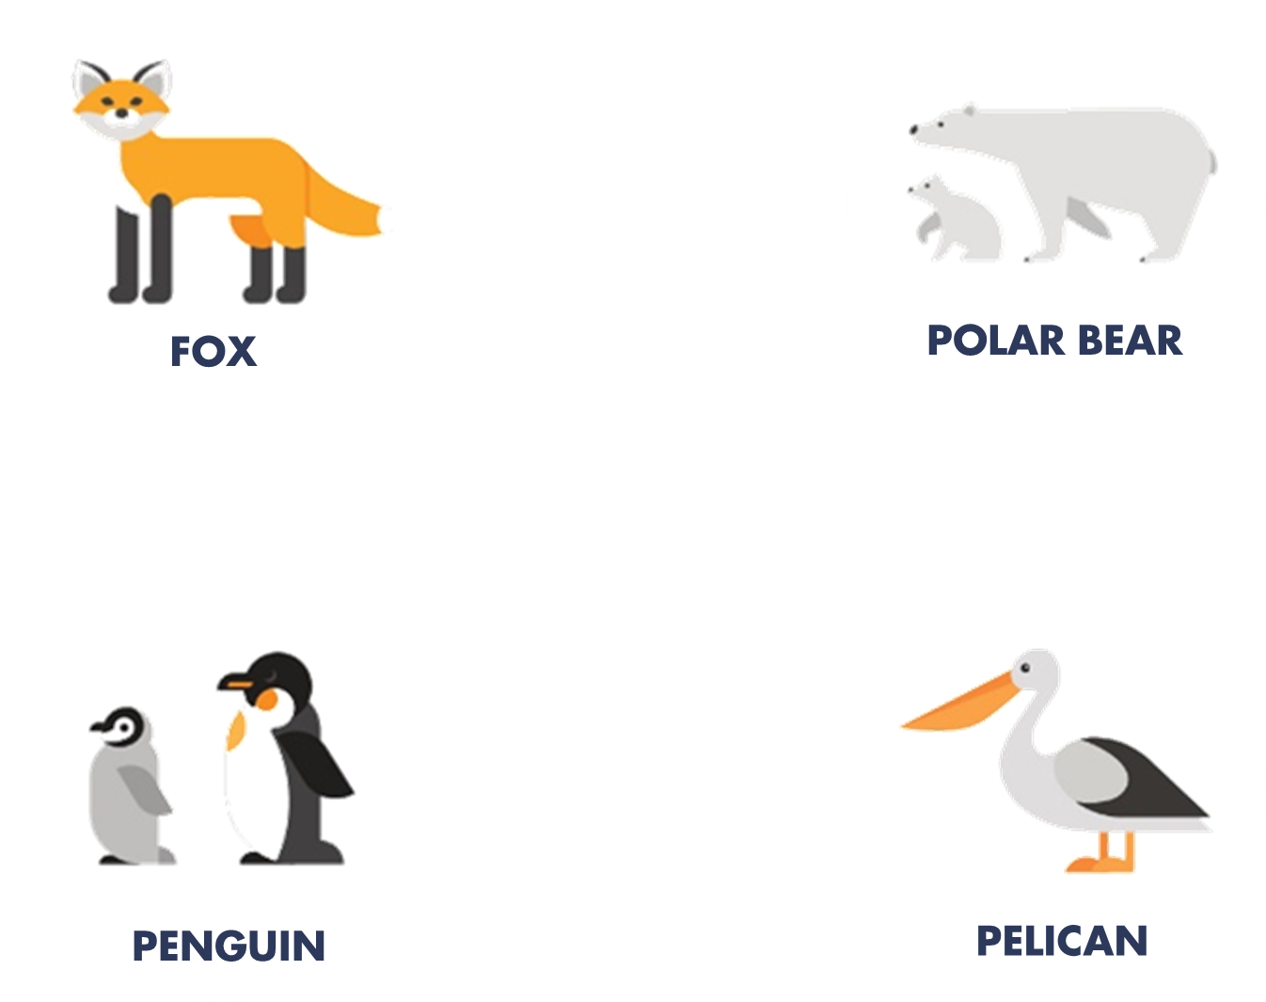

Slide 46
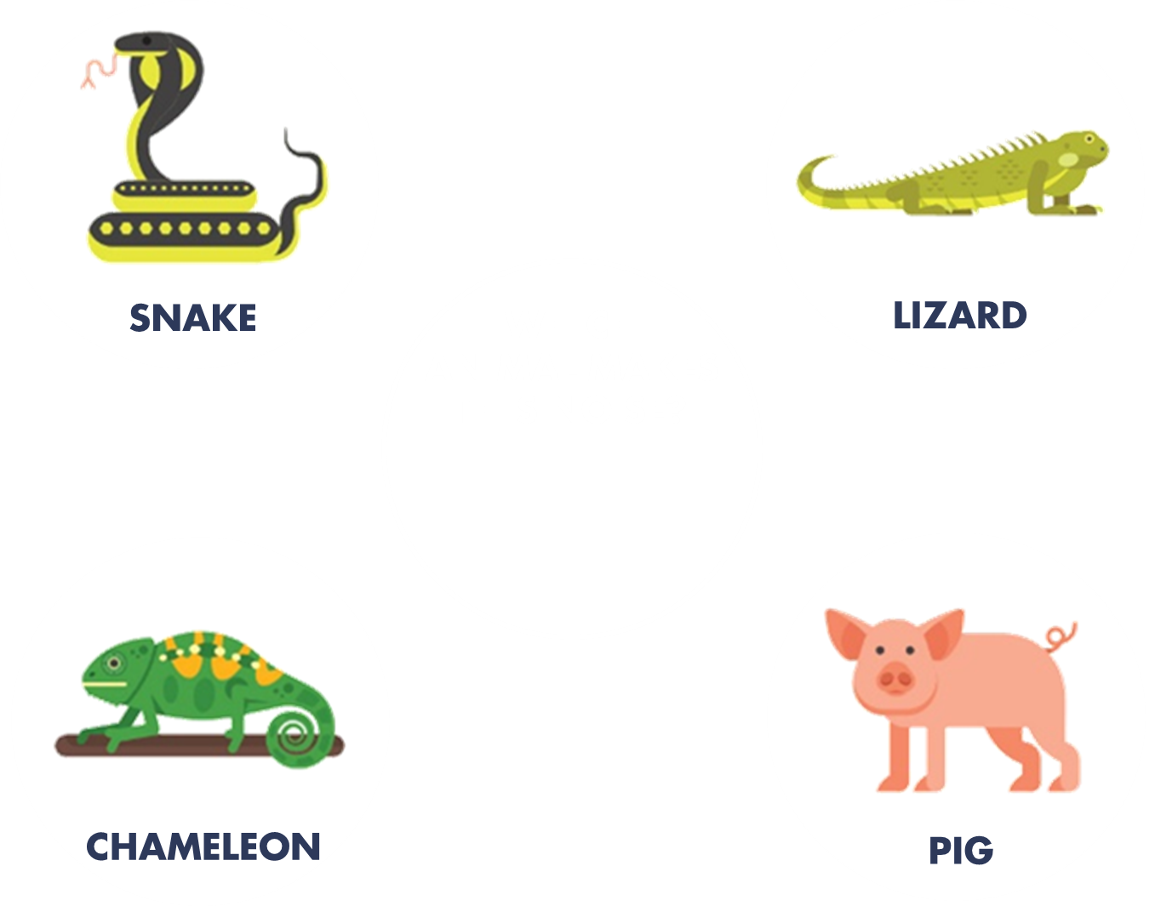

Slide 47
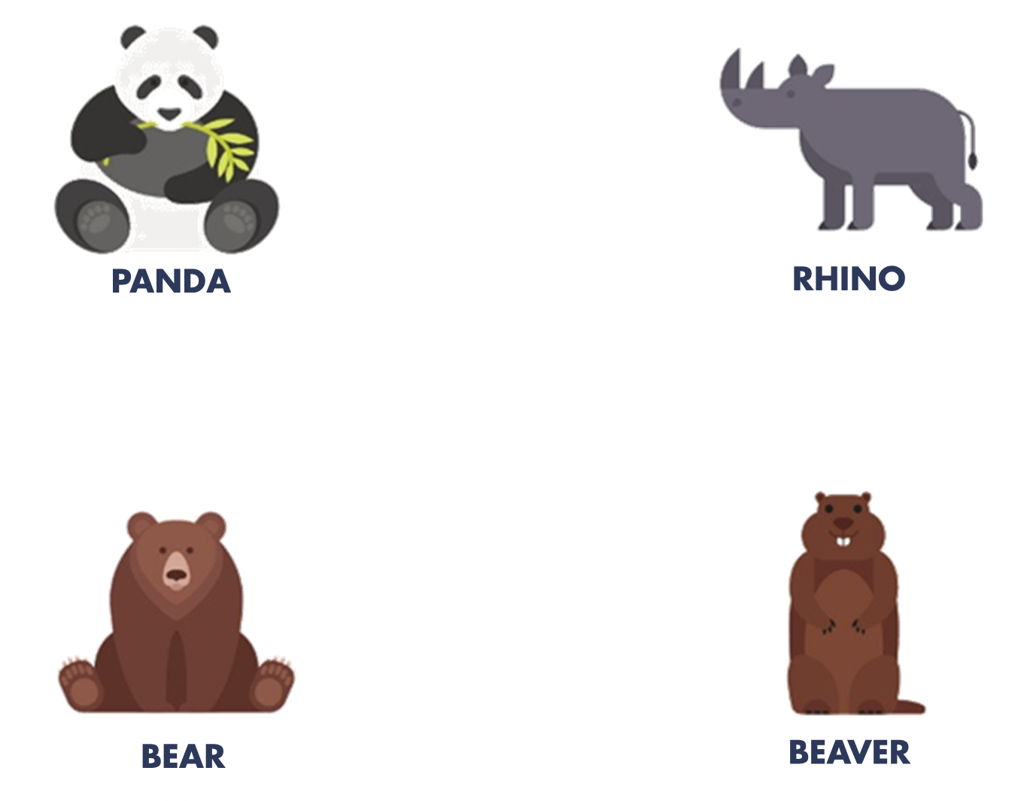

Slide 48
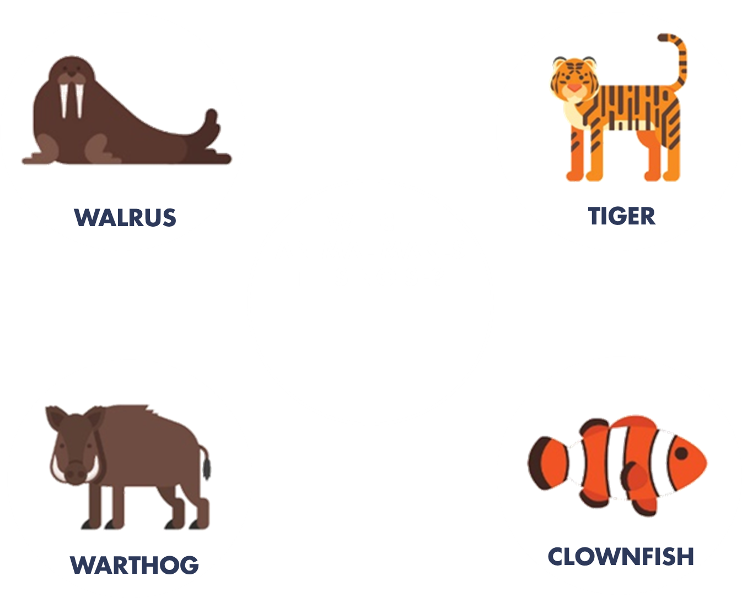

Slide 49
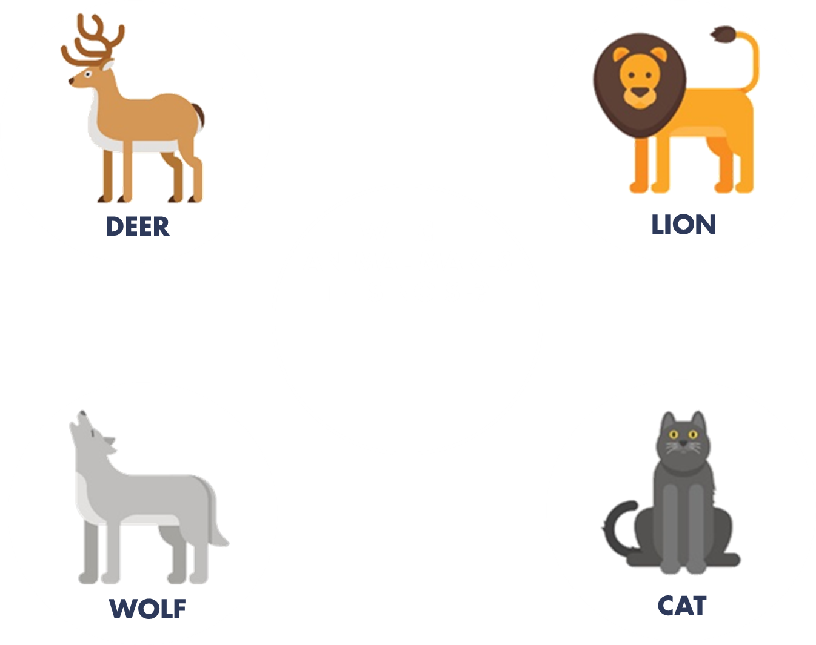

Slide 50
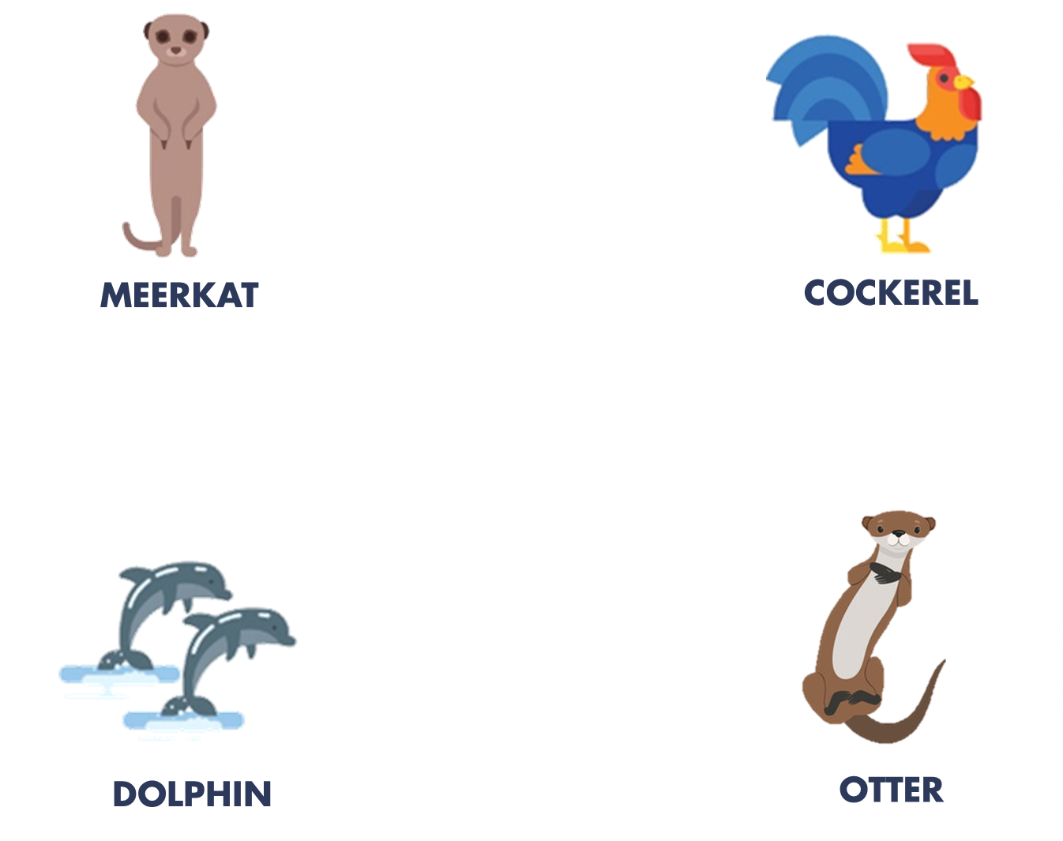

Slide 52

This week’s challenge . . .

Slide 53
Next week . . .
Insert what you will be doing here!

