Slide 1
Company & Seniors Taster Programme – Week 1
_________________________________________________________
If you have not already downloaded and installed the Brigade fonts used in this presentation you can download our font pack at
http://leaders.boys-brigade.org.uk/ourbrand.htm
Alternatively you may just need to check through the presentation to ensure the substitute font used is displaying correctly.
_________________________________________________________
All elements of the programme that need to be shown on screen are included in this presentation. Please remove any elements you do not need. This PowerPoint presentation will have any videos mentioned in the programme embedded into it. When you come to these click the play button to start the video. Ensure when sharing your screen through Zoom you tick the ‘Share Computer Sound’ box.
_________________________________________________________
Please check through and edit text as required. As an example some photos of the previous week’s ‘Takeaway Challenge’ are shown, this is a space you could use to share photos that have been sent in by parents/carers and updated each week. The young people will love seeing themselves here ☺
A template points chart is also included which you can update each week and share as part of your virtual session.

Slide 2


Slide 3

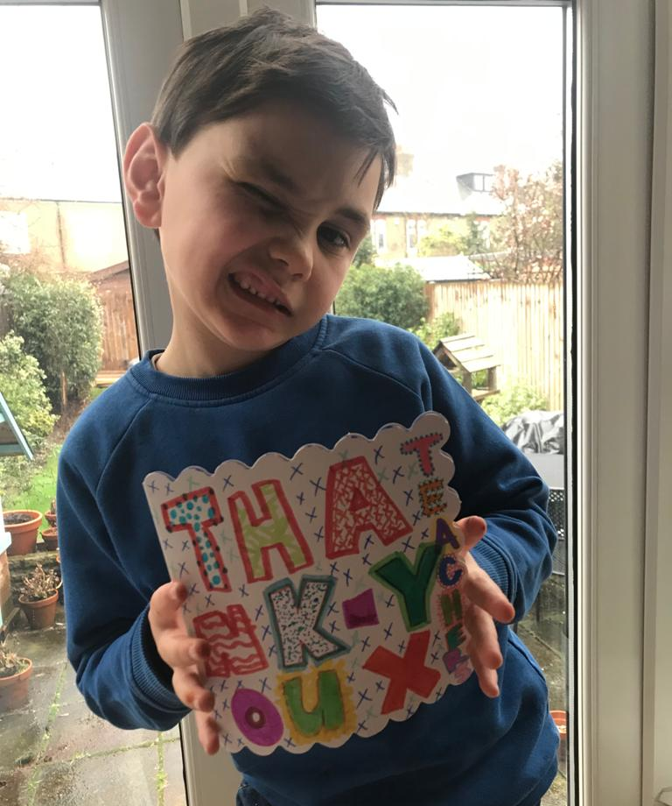
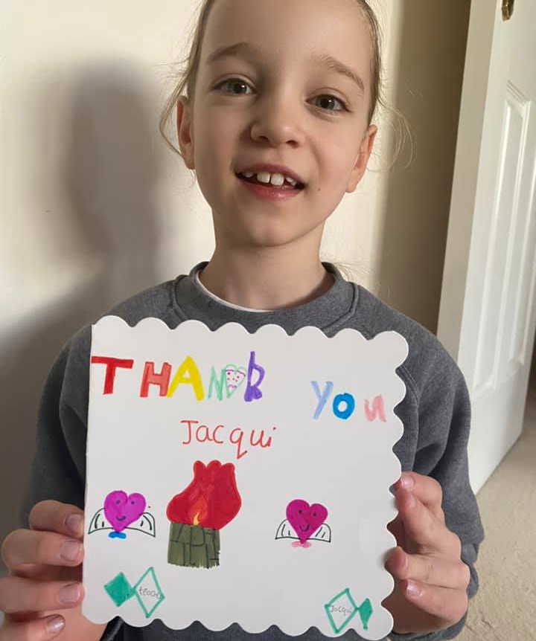

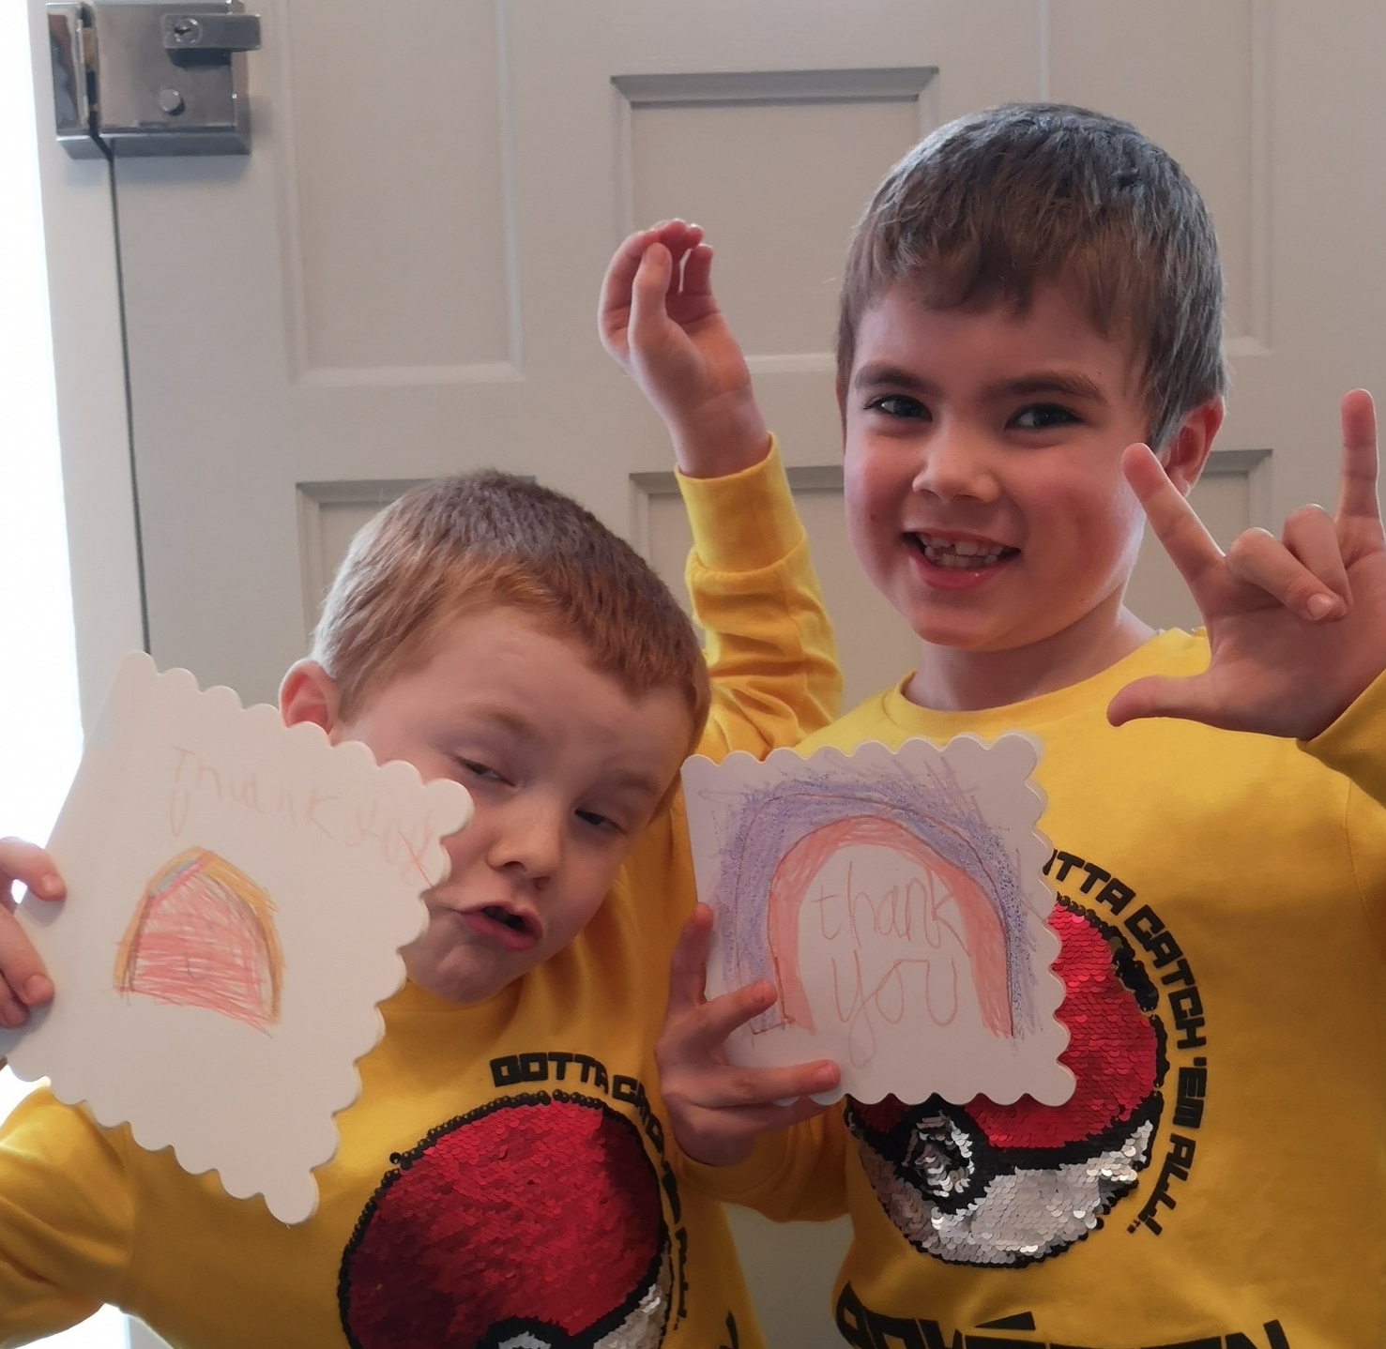
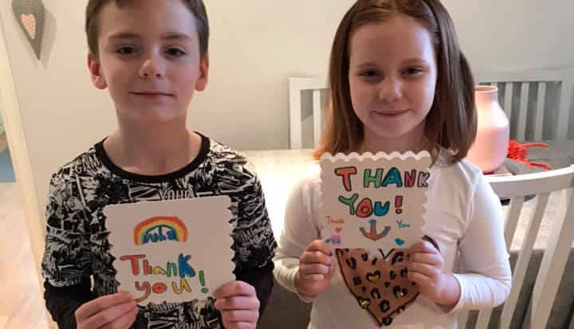
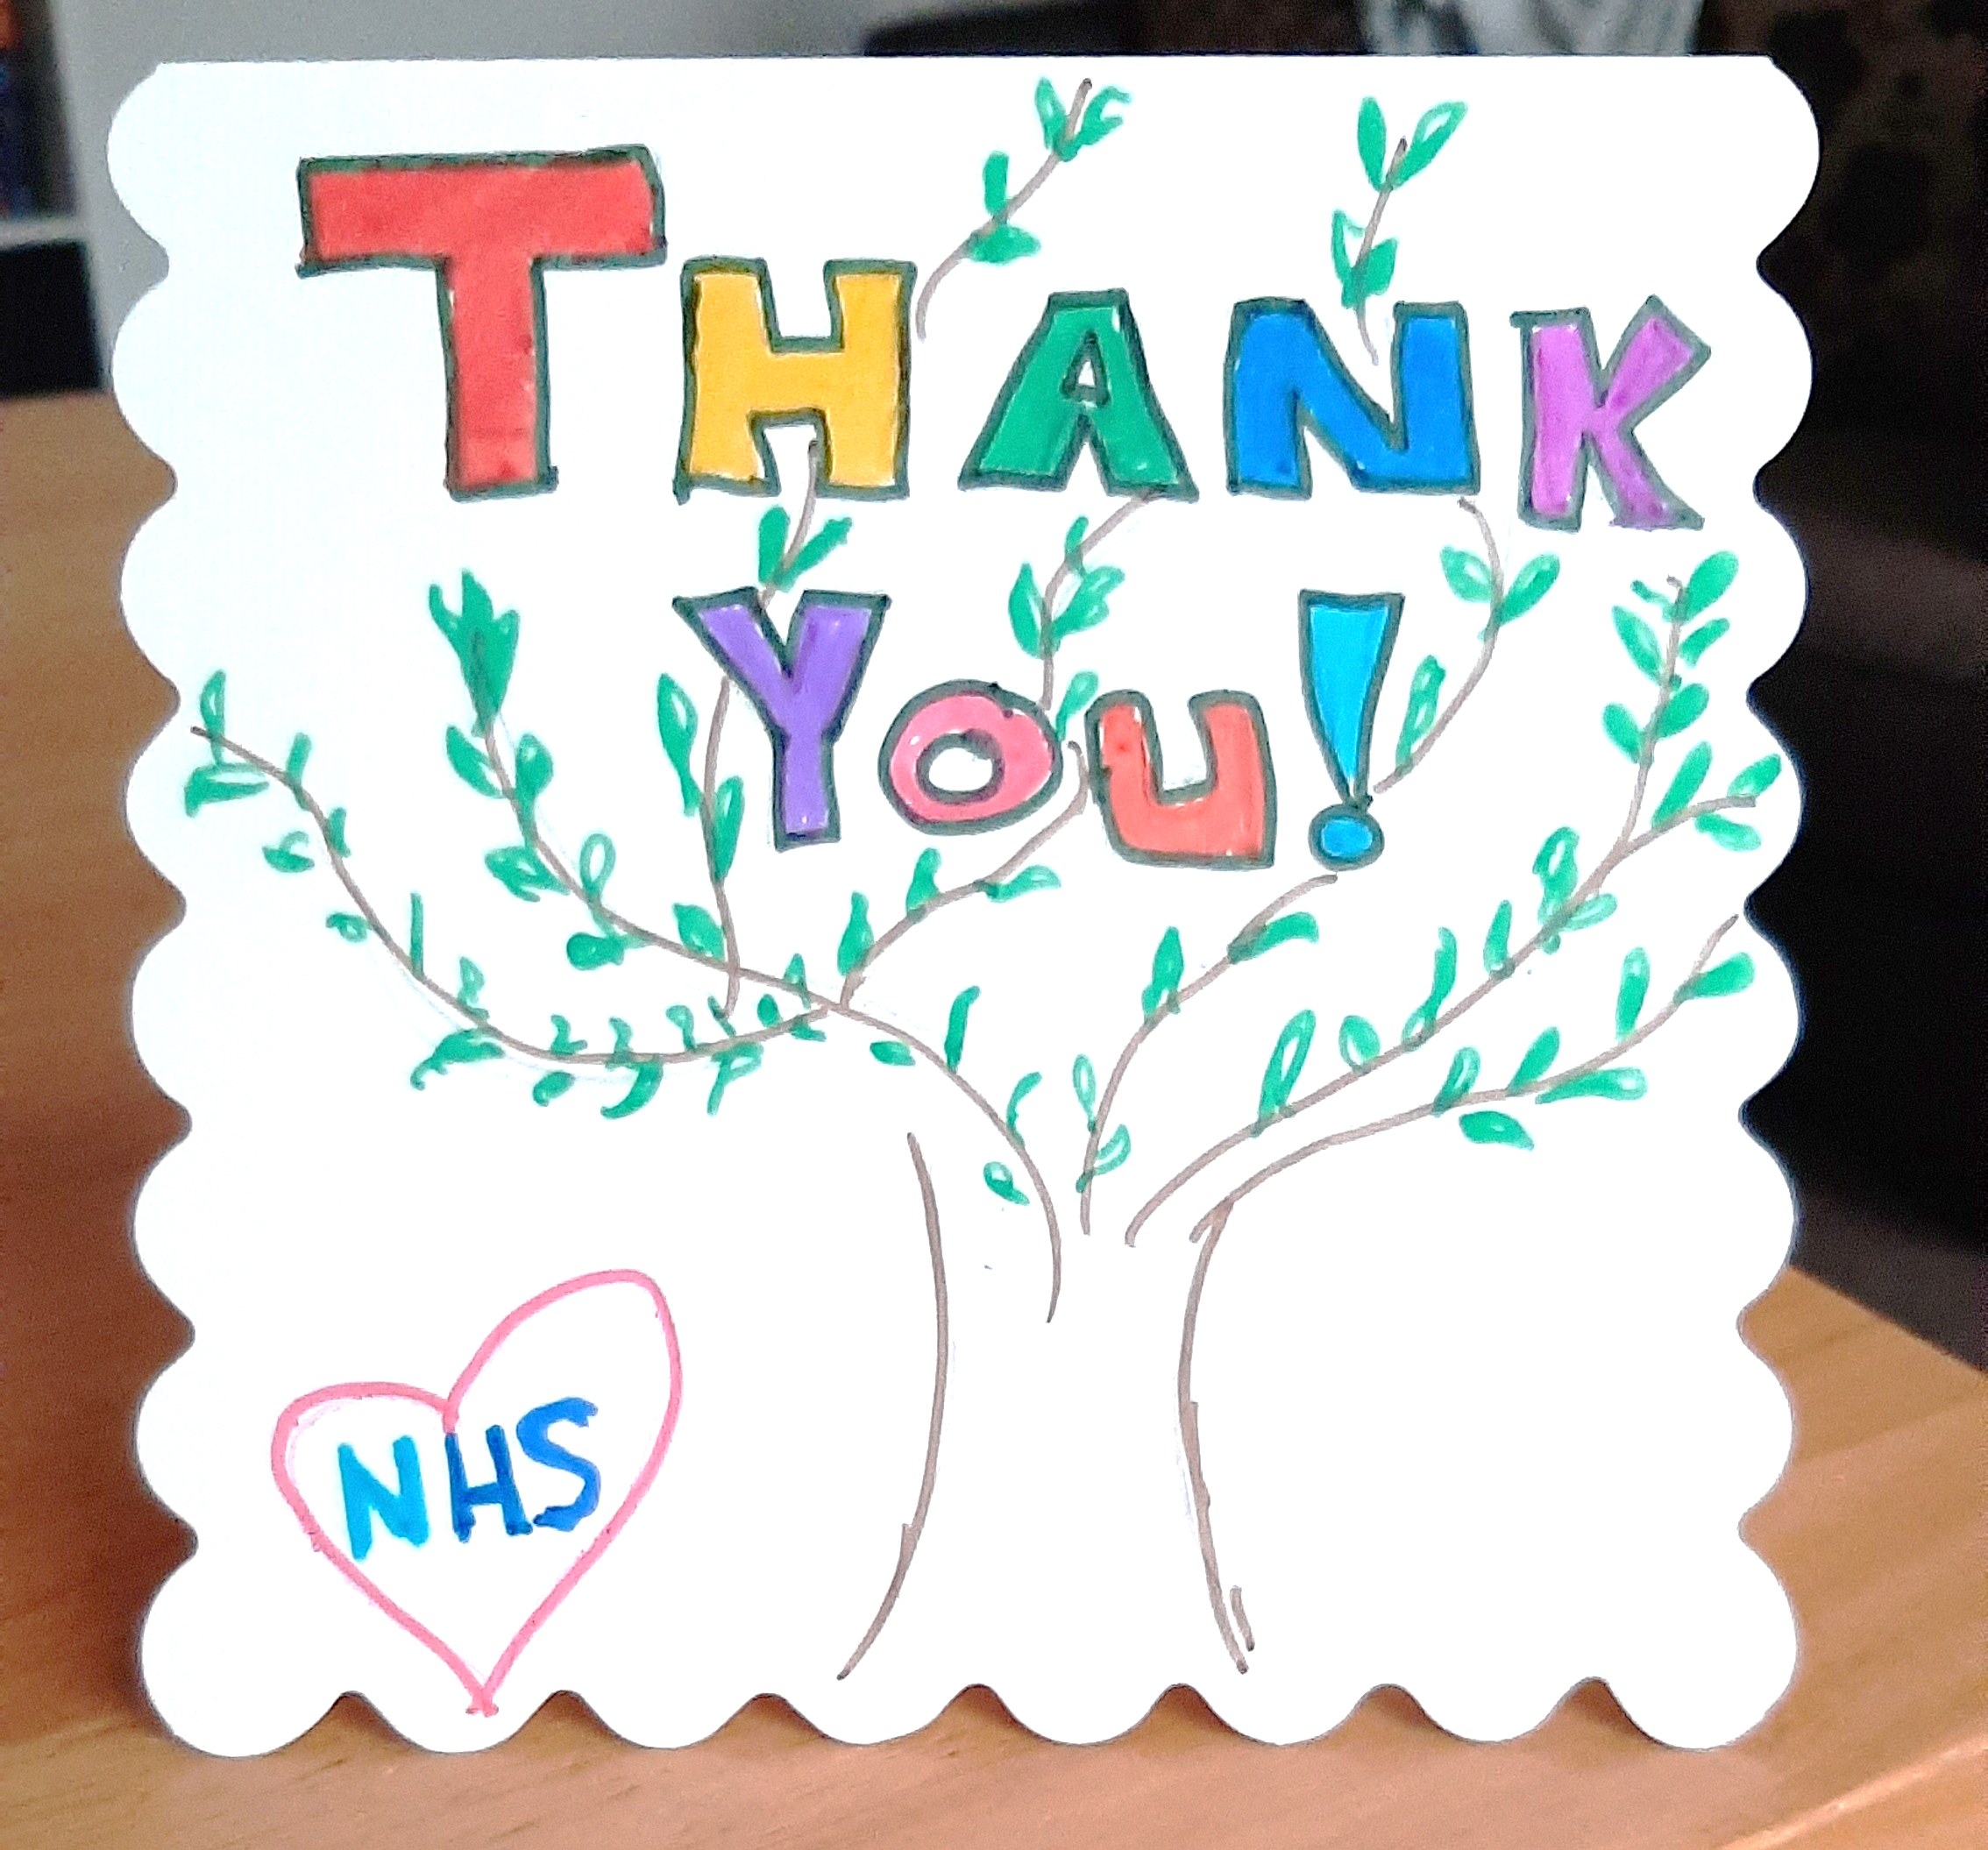
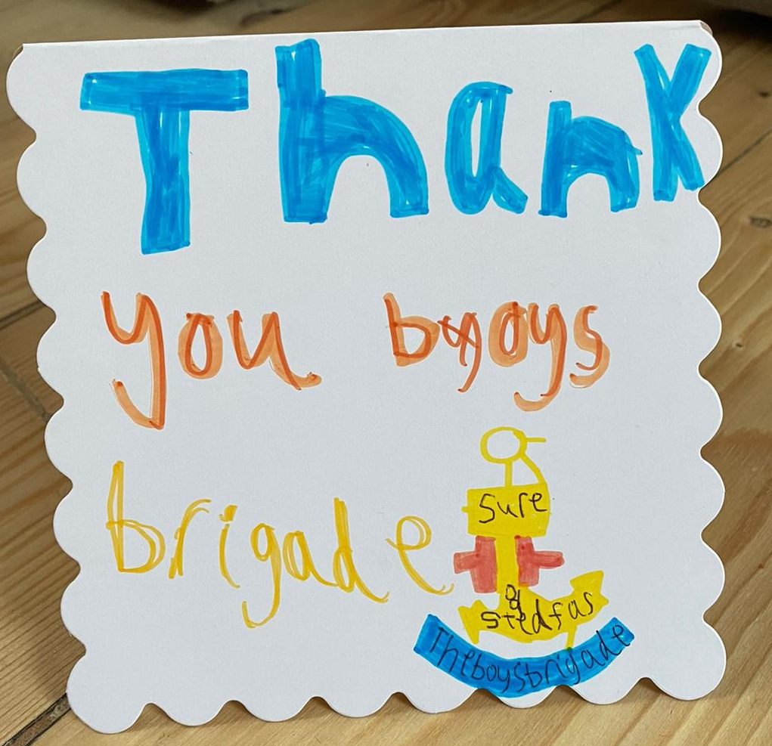
Last week’s challenge . . .

Slide 4

Remember to share your photos with us
Send by email to xxxxxxx or via WhatsApp/SMS/Social Media

Slide 5
#BBatHOME Points Chart
Names | Activities Complete | Virtual Sessions Attended | Total Points | Current Medal
Child 1 | 20 | 15 | 35 | Gold (35+)
Child 2
Child 3
Child 4
Child 5
Child 6
Child 7
Child 8
Child 9
Child 10
Child 11
Child 12
Child 13
Child 14
Child 15
We will update points each week and share on our Virtual Sessions!
Medals will be awarded as follows:
Bronze = 10+ Points / Silver = 20+ Points / Gold = 35+ Points / Diamond = 50+ Points / Platinum = 75+ Points

Slide 7


Slide 8


Slide 9


Slide 10


Slide 11


Slide 12


Slide 13


Slide 14


Slide 15


Slide 16


Slide 17
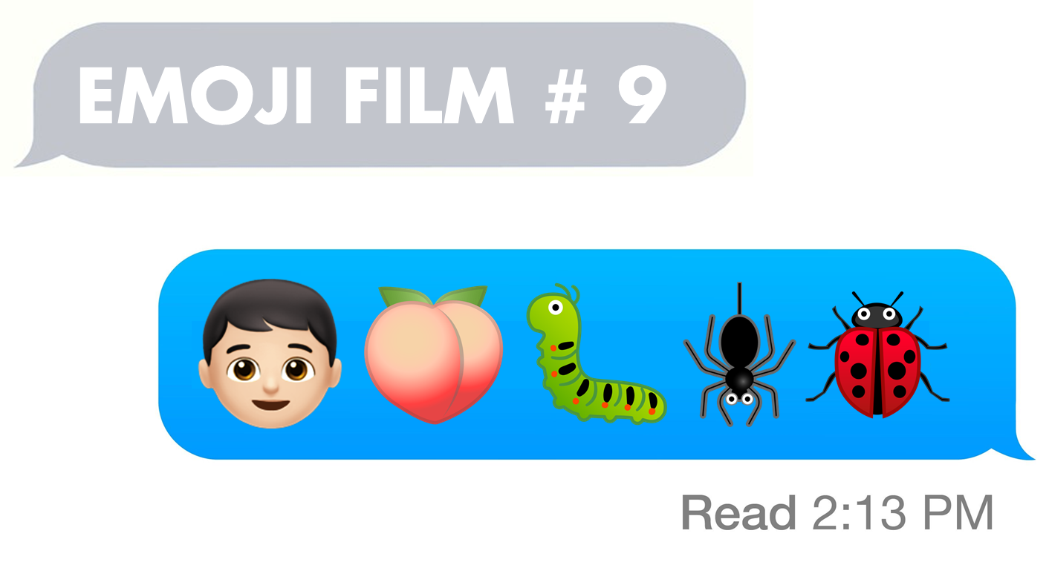

Slide 18


Slide 19


Slide 20


Slide 21


Slide 22


Slide 23
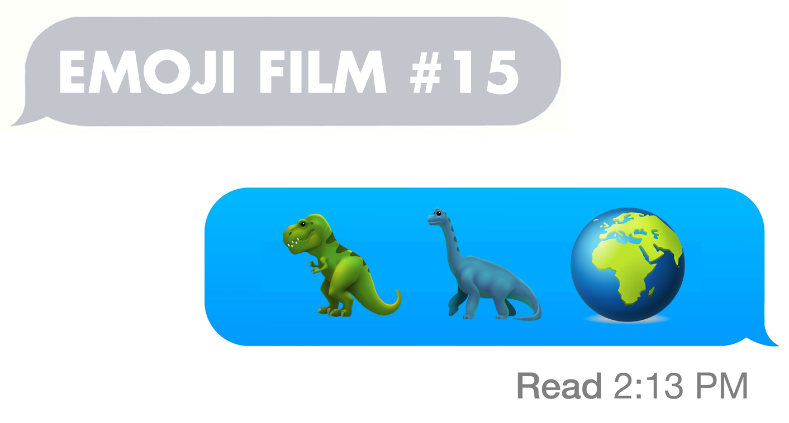

Slide 24


Slide 25
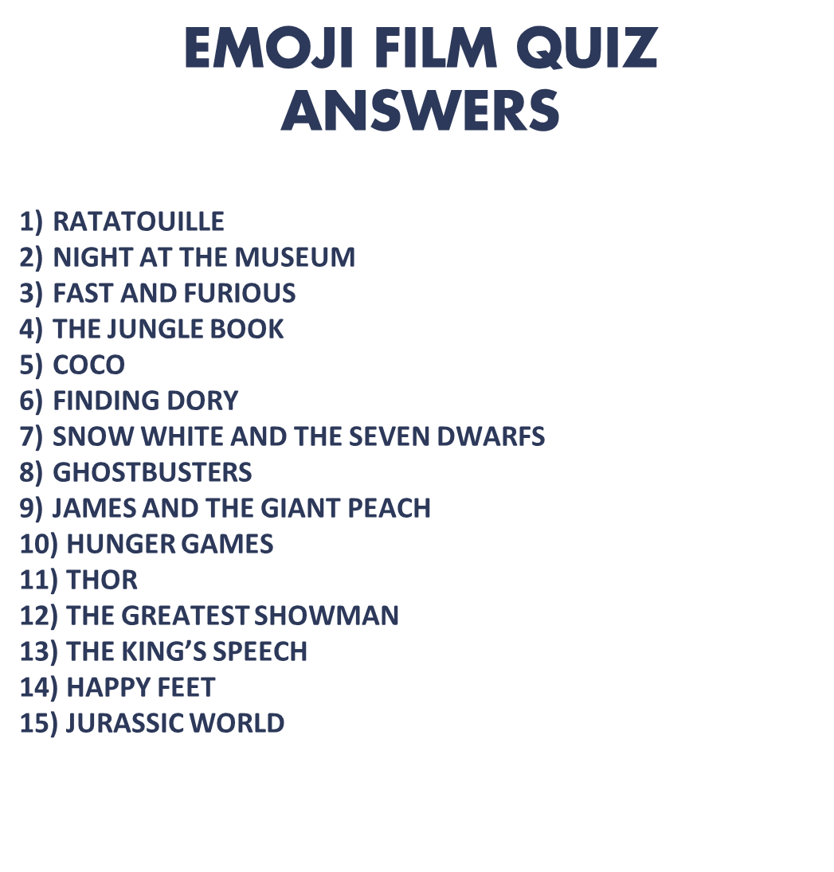

Slide 27


Slide 28


Slide 29


Slide 30


Slide 31


Slide 32


Slide 33


Slide 34


Slide 36

This week’s challenge . . .

Slide 37

Next week . . .

