Slide 1
Company & Seniors Week 3 Taster Programme
_________________________________________________________
If you have not already downloaded and installed the Brigade fonts used in this presentation you can download our font pack at
http://leaders.boys-brigade.org.uk/ourbrand.htm
Alternatively you may just need to check through the presentation to ensure the substitute font used is displaying correctly.
_________________________________________________________
All elements of the programme that need to be shown on screen are included in this presentation. Please remove any elements you do not need. This PowerPoint presentation will have any videos mentioned in the programme embedded into it. When you come to these click the play button to start the video. Ensure when sharing your screen through Zoom you tick the ‘Share Computer Sound’ box.
_________________________________________________________
Please check through and edit text as required. Rember to remind parents / carers to send in photos of their child taking part in the ‘Takeaway Challenge’ and add these in on the ‘Last week’s challenge’ slide. The young people will love seeing themselves here ☺
A template points chart is also included which you can update each week and share as part of your virtual session.

Slide 2


Slide 3

Last week’s challenge . . .
Add photos sent in by parents/carers here!

Slide 4

Remember to share your photos with us
Send by email to xxxxxxx or via WhatsApp/SMS/Social Media

Slide 5
#BBatHOME Points Chart
Copy and paste your latest points chart from the previous week here
We will update points each week and share on our Virtual Sessions!
Medals will be awarded as follows:
Bronze = 10+ Points / Silver = 20+ Points / Gold = 35+ Points / Diamond = 50+ Points / Platinum = 75+ Points

Slide 7


Slide 9

A Question of Sport

Slide 10
Round 1:
Sports General knowledge

Slide 11
Question 1:
Who won the Premier League’s Golden Boot (most goals scored) for the 2019/20 season?
Round 1 – Sport General Knowledge

Slide 12
Question 2:
What Colours are the 5 Olympic rings?
Round 1 – Sport General Knowledge

Slide 13
Question 3:
Name the four Grand Slam events in tennis?
Round 1 – Sport General Knowledge

Slide 14
Question 4:
What is the total of:
Players in a football team
Maximum score in darts (3 throws)
Value of the black ball in snooker
Number of miles in a marathon
Round 1 – Sport General Knowledge

Slide 15
Question 5:
What major sporting event takes place at Aintree each April?
Round 1 – Sport General Knowledge

Slide 16
Question 6:
Which sport includes the terms ‘house’ and ‘hammer’ and equipment called ‘stones’ and ‘brooms’?
Round 1 – Sport General Knowledge

Slide 17
Question 7:
Which team does Lewis Hamilton drive for in F1?
Round 1 – Sport General Knowledge

Slide 18
Question 8:
Which country’s rugby team is called the Springboks?
Round 1 – Sport General Knowledge

Slide 19
Question 9:
True or False? Skateboarding was due to make its Olympic debut at the Tokyo 2020 Games?
Round 1 – Sport General Knowledge

Slide 20
Question 10:
In bowling, what is the name given for achieving three consecutive strikes?
Round 1 – Sport General Knowledge

Slide 21
Round 1:
Sports General knowledge
Answers

Slide 22
Sport General Knowledge Answers
Jamie Vardy (Leicester City FC)
Red, Yellow, Blue, Green, Black
Australian Open, French Open, Wimbledon, US Open
11 + 180 + 7 + 26 = 224
Grand National (Horse Racing)
Curling
Mercedes
South Africa
True
Turkey

Slide 23
Round 2:
Famous Sporting Faces

Slide 24
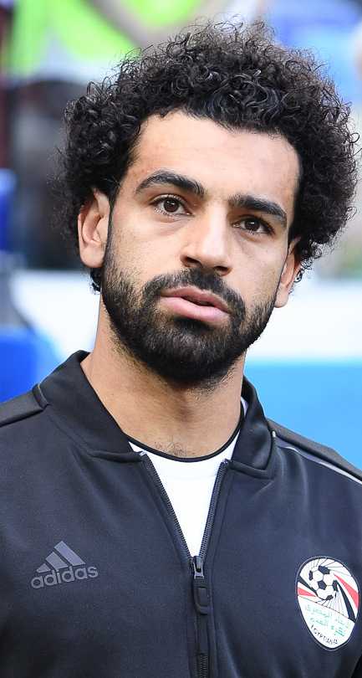
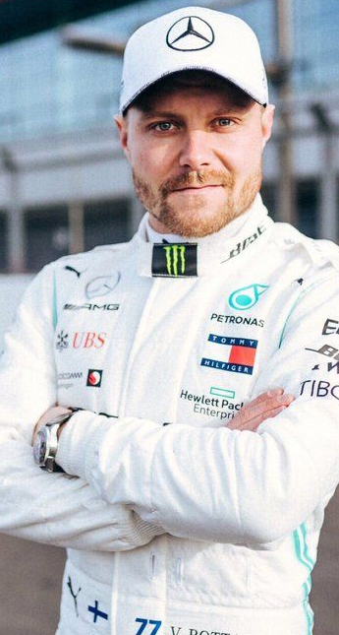
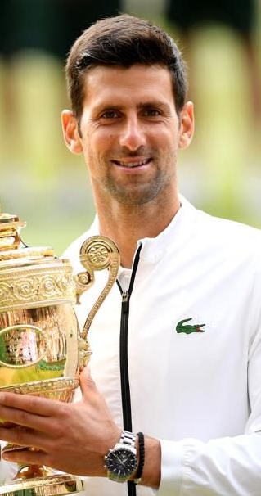
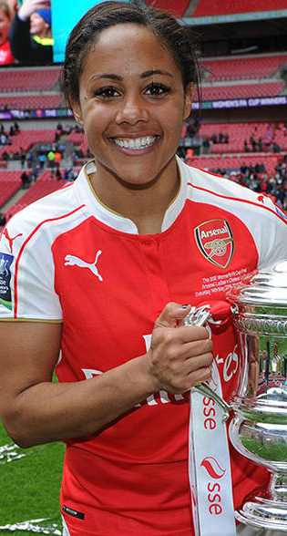
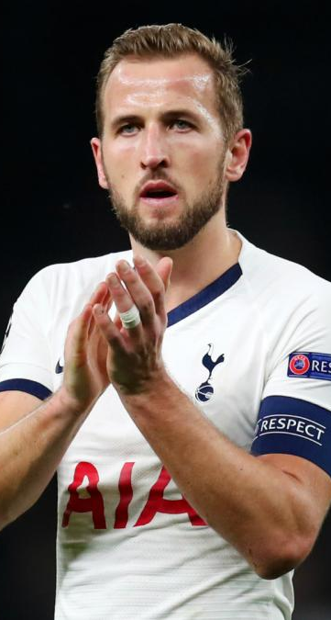
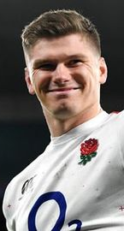
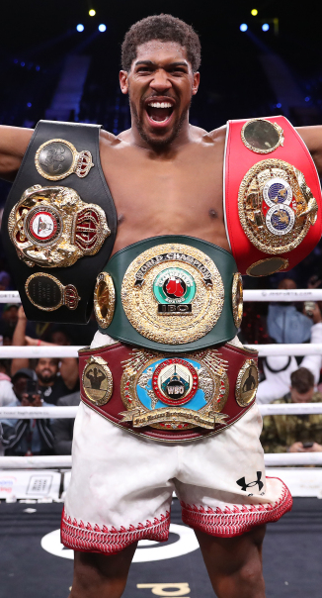
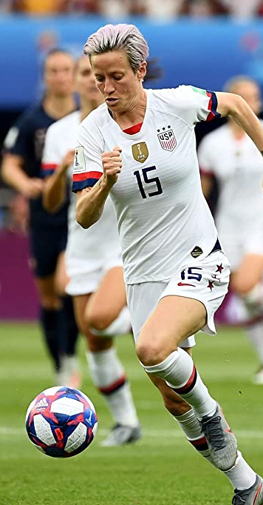
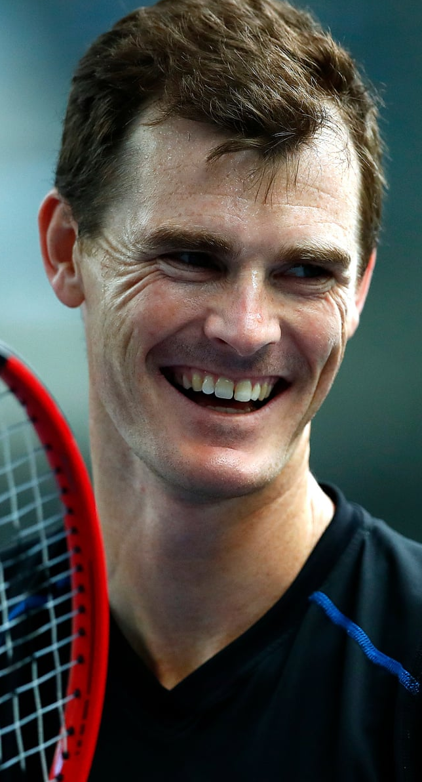
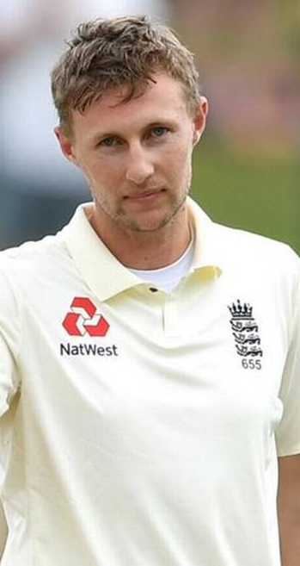

Slide 25
Famous Sporting Faces Answers
Mo Salah
Valtteri Bottas
Novak Djokovic
Alex Scott
Harry Kane
Owen Farrell
Anthony Joshua
Megan Rapinoe
Jamie Murray
Joe Root

Slide 26
Round 3:
Name the stadium/Ground/Venue

Slide 27
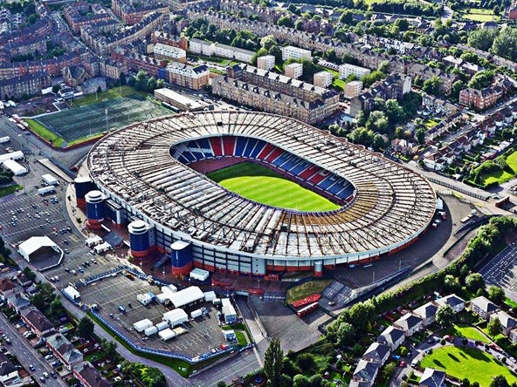
1

Slide 28
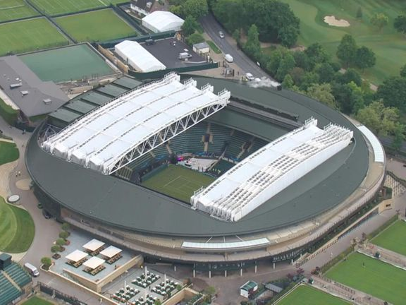
2

Slide 29
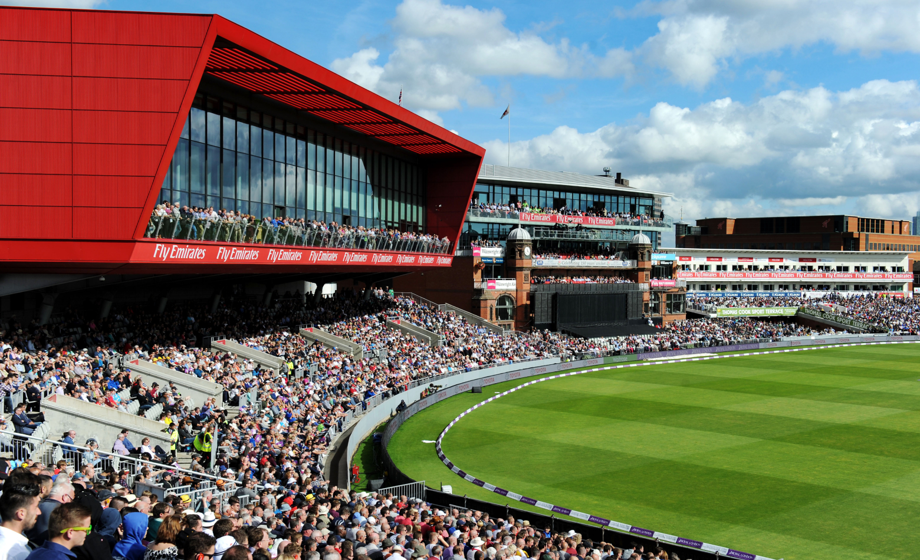
3

Slide 30
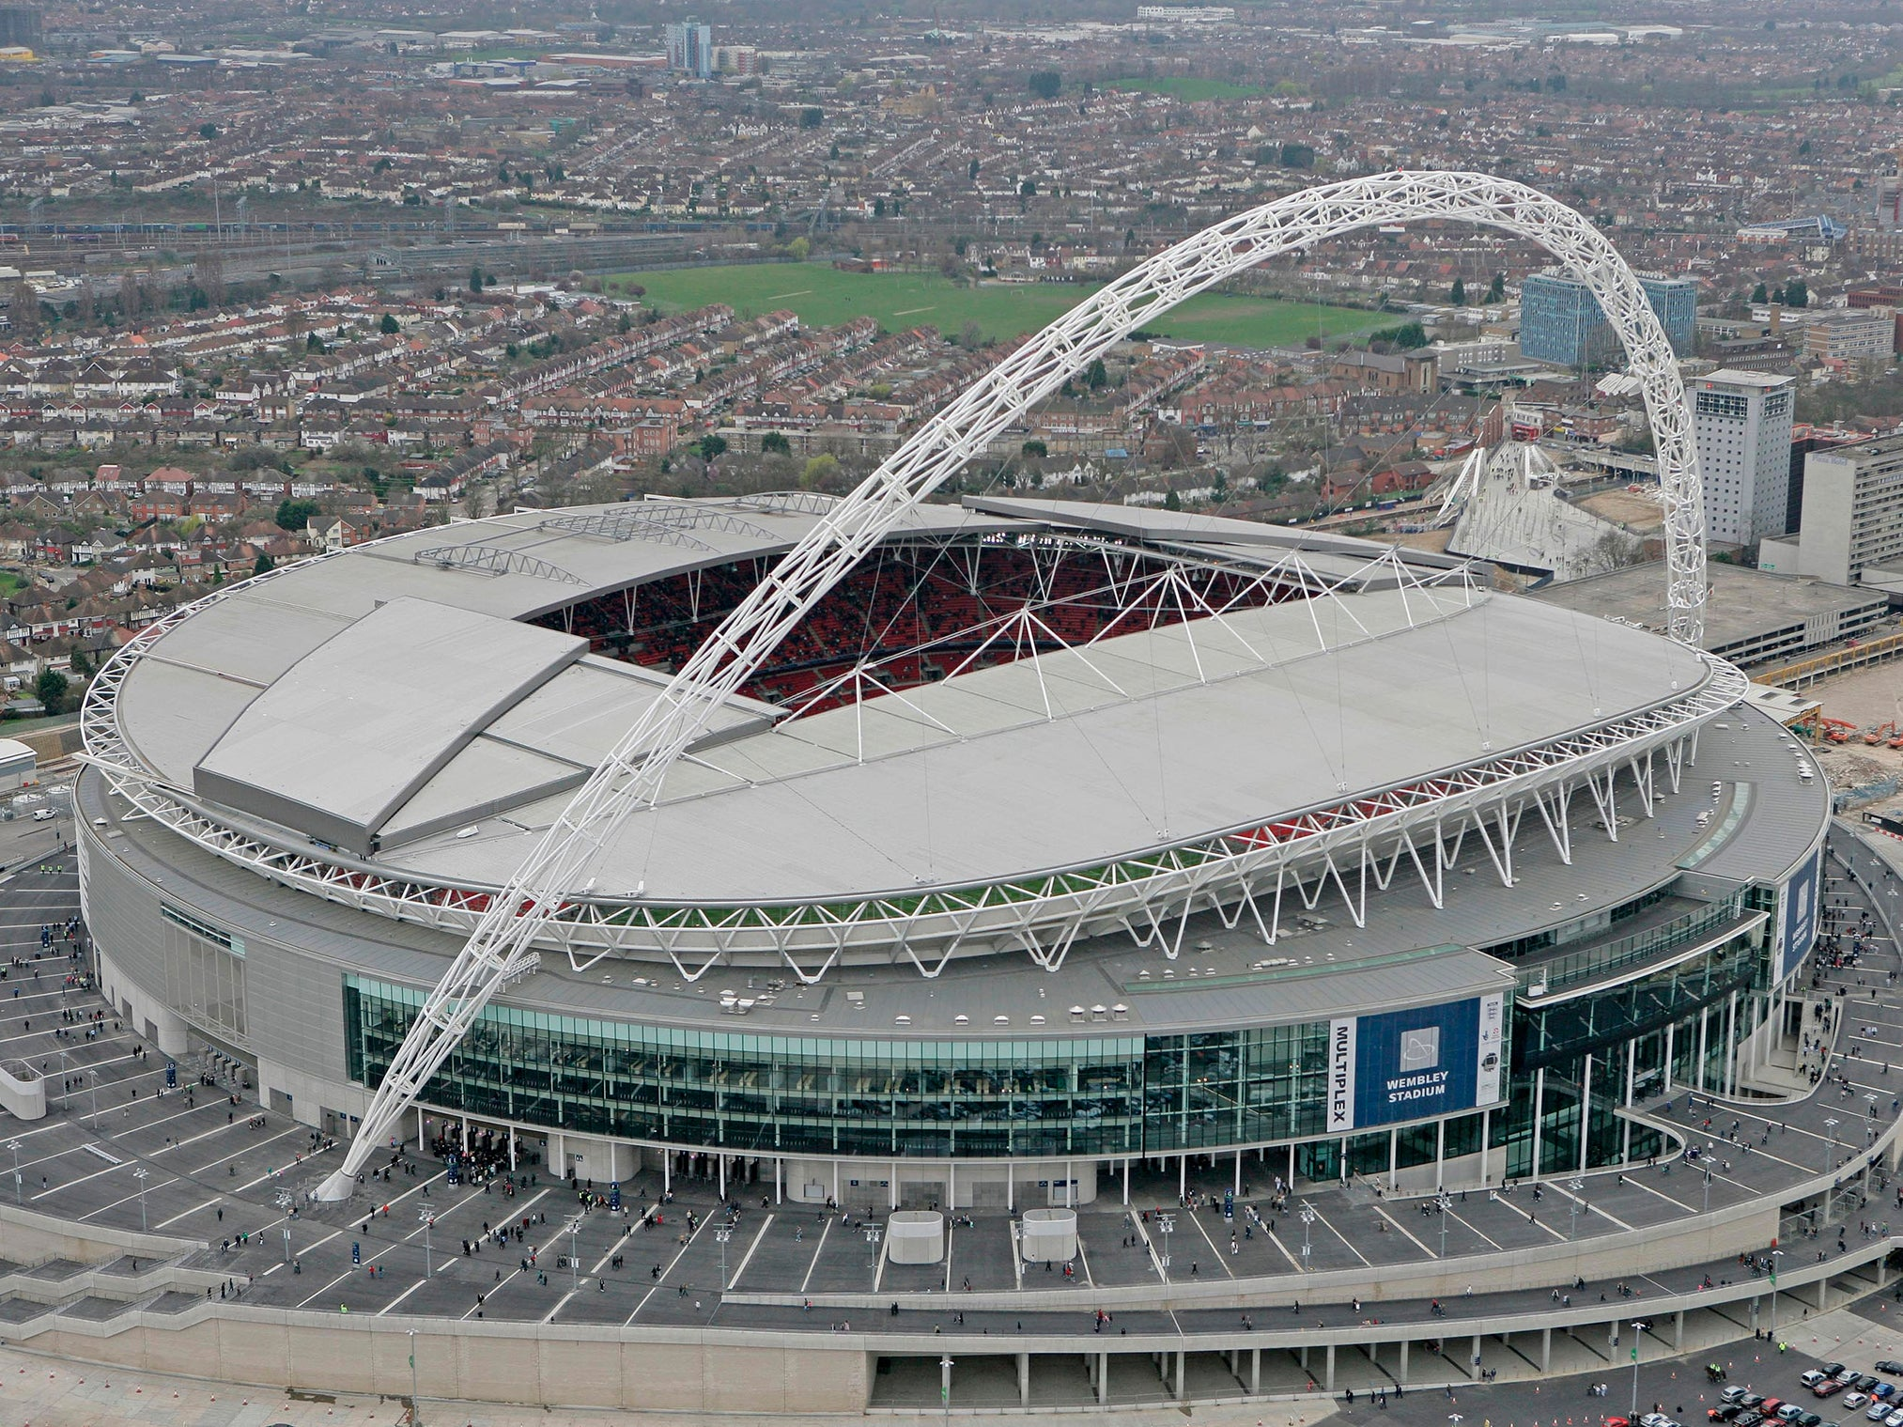
4

Slide 31
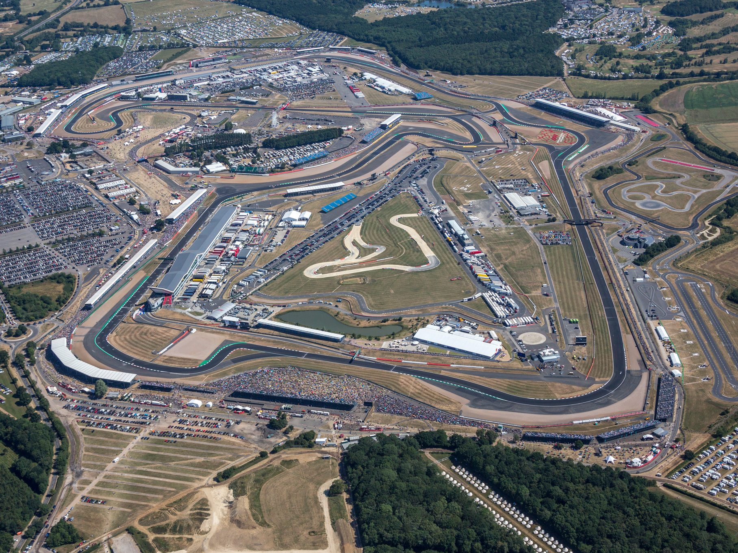
5

Slide 32
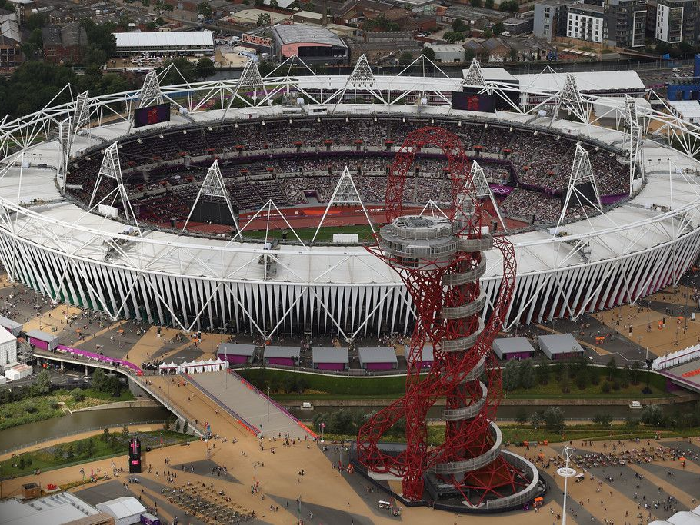
6

Slide 33
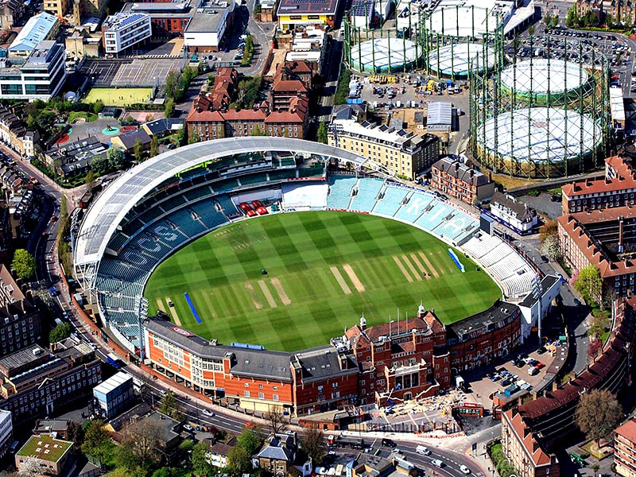
7

Slide 34
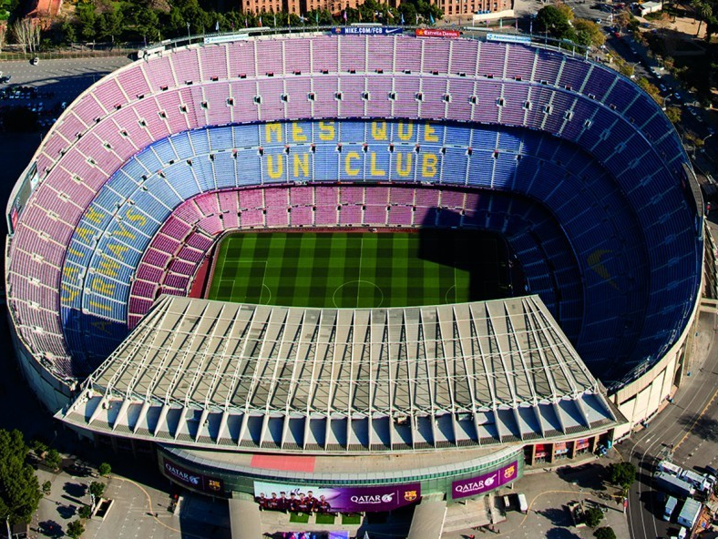
8

Slide 35
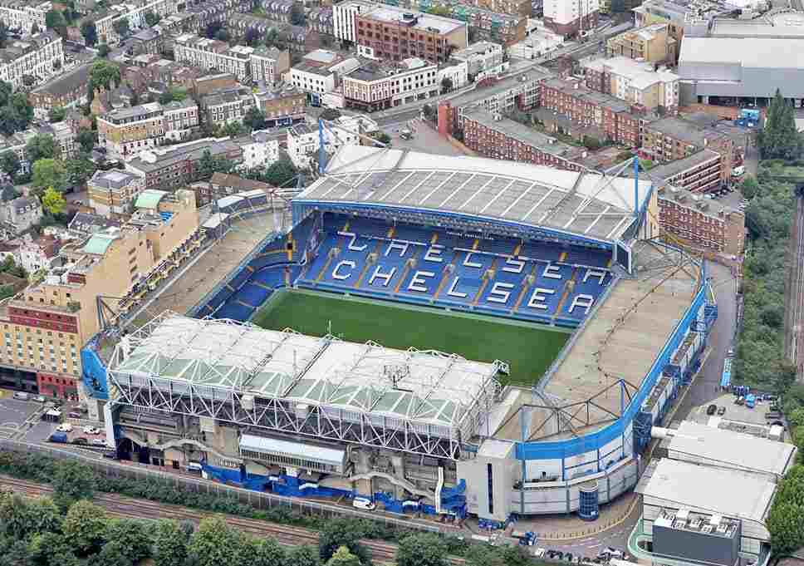
9

Slide 36
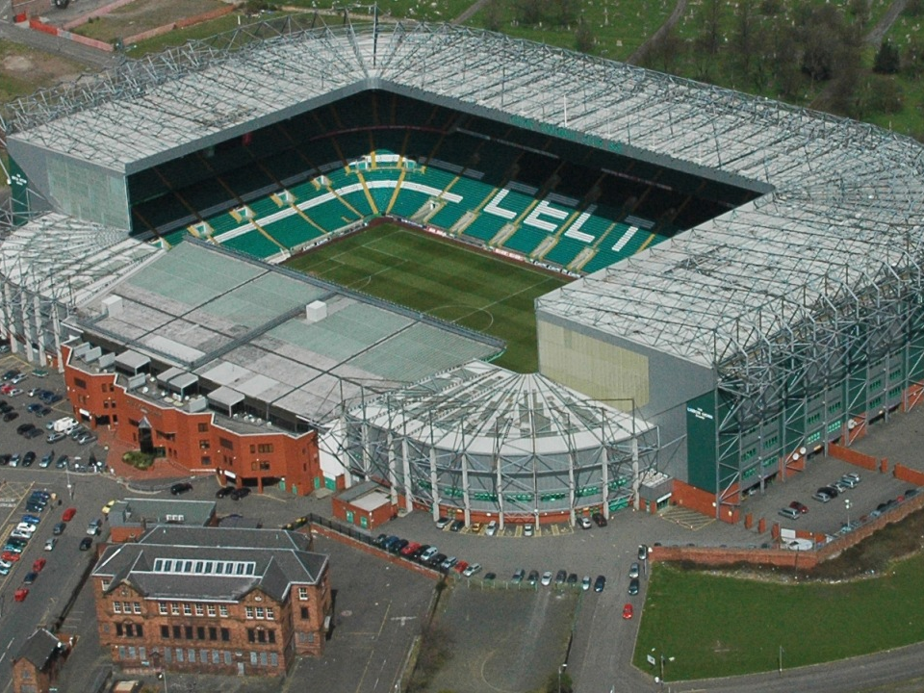
10

Slide 37
Round 3:
Name the stadium/Ground/Venue Answers

Slide 38
Name the stadium/Ground/Venue Answers
Hampden Park
Centre Court (Wimbledon)
Old Trafford Cricket Ground
Wembley
Silverstone Circuit
Olympic Stadium / London Stadium
The Oval
Camp Nou (Barcelona)
Stamford Brigade (Chelsea)
Celtic Park (Celtic)

Slide 40


Slide 42
Sporting Charades

Slide 43
High Jump

Slide 44
Rowing

Slide 45
Hockey

Slide 46
100 Metres

Slide 47
Fencing

Slide 48
Lewis Hamilton

Slide 49
Diving

Slide 50
London Marathon

Slide 51
Darts

Slide 52
Olympics

Slide 53
Football

Slide 54
Javelin

Slide 55
Bobsleigh

Slide 56
Andy Murray

Slide 57
Referee

Slide 58
Badminton

Slide 59
Tennis Racket

Slide 60
Slam
Dunk

Slide 61
Winter Olympics

Slide 62
Rugby

Slide 63
Sports Stadium

Slide 64
Weight lifting

Slide 65
Wayne Rooney

Slide 66
BMX Racing

Slide 67
Shot
Put

Slide 68
Netball

Slide 69
Skateboarding

Slide 70
Horse Jumping

Slide 71
Skiing

Slide 72
Basketball

Slide 73
Baseball

Slide 74
Surfing

Slide 75
World
Cup

Slide 76
Curling

Slide 77
Table Tennis

Slide 78
Triple
Jump

Slide 79
Rock Climbing

Slide 80
Snooker

Slide 81
GOLF

Slide 82
Sailing

Slide 83
Volleyball

Slide 84
Dressage

Slide 85
American Football

Slide 86
Hurdles

Slide 87
Sumo Wrestling

Slide 88
Ice Hockey

Slide 89
10 pin bowling

Slide 90
Boxing

Slide 92

This week’s challenge . . .

Slide 93

Next week . . .

