Slide 1
Company & Seniors Week 4 Taster Programme
_________________________________________________________
If you have not already downloaded and installed the Brigade fonts used in this presentation you can download our font pack at
http://leaders.boys-brigade.org.uk/ourbrand.htm
Alternatively you may just need to check through the presentation to ensure the substitute font used is displaying correctly.
_________________________________________________________
All elements of the programme that need to be shown on screen are included in this presentation. Please remove any elements you do not need. This PowerPoint presentation will have any videos mentioned in the programme embedded into it. When you come to these click the play button to start the video. Ensure when sharing your screen through Zoom you tick the ‘Share Computer Sound’ box.
_________________________________________________________
Please check through and edit text as required. Rember to remind parents / carers to send in photos of their child taking part in the ‘Takeaway Challenge’ and add these in on the ‘Last week’s challenge’ slide. The young people will love seeing themselves here ☺
A template points chart is also included which you can update each week and share as part of your virtual session.

Slide 2


Slide 3

Last week’s challenge . . .
Add photos sent in by parents/carers here!

Slide 4

Remember to share your photos with us
Send by email to xxxxxxx or via WhatsApp/SMS/Social Media

Slide 5
#BBatHOME Points Chart
Copy and paste your latest points chart from the previous week here
We will update points each week and share on our Virtual Sessions!
Medals will be awarded as follows:
Bronze = 10+ Points / Silver = 20+ Points / Gold = 35+ Points / Diamond = 50+ Points / Platinum = 75+ Points

Slide 7


Slide 9
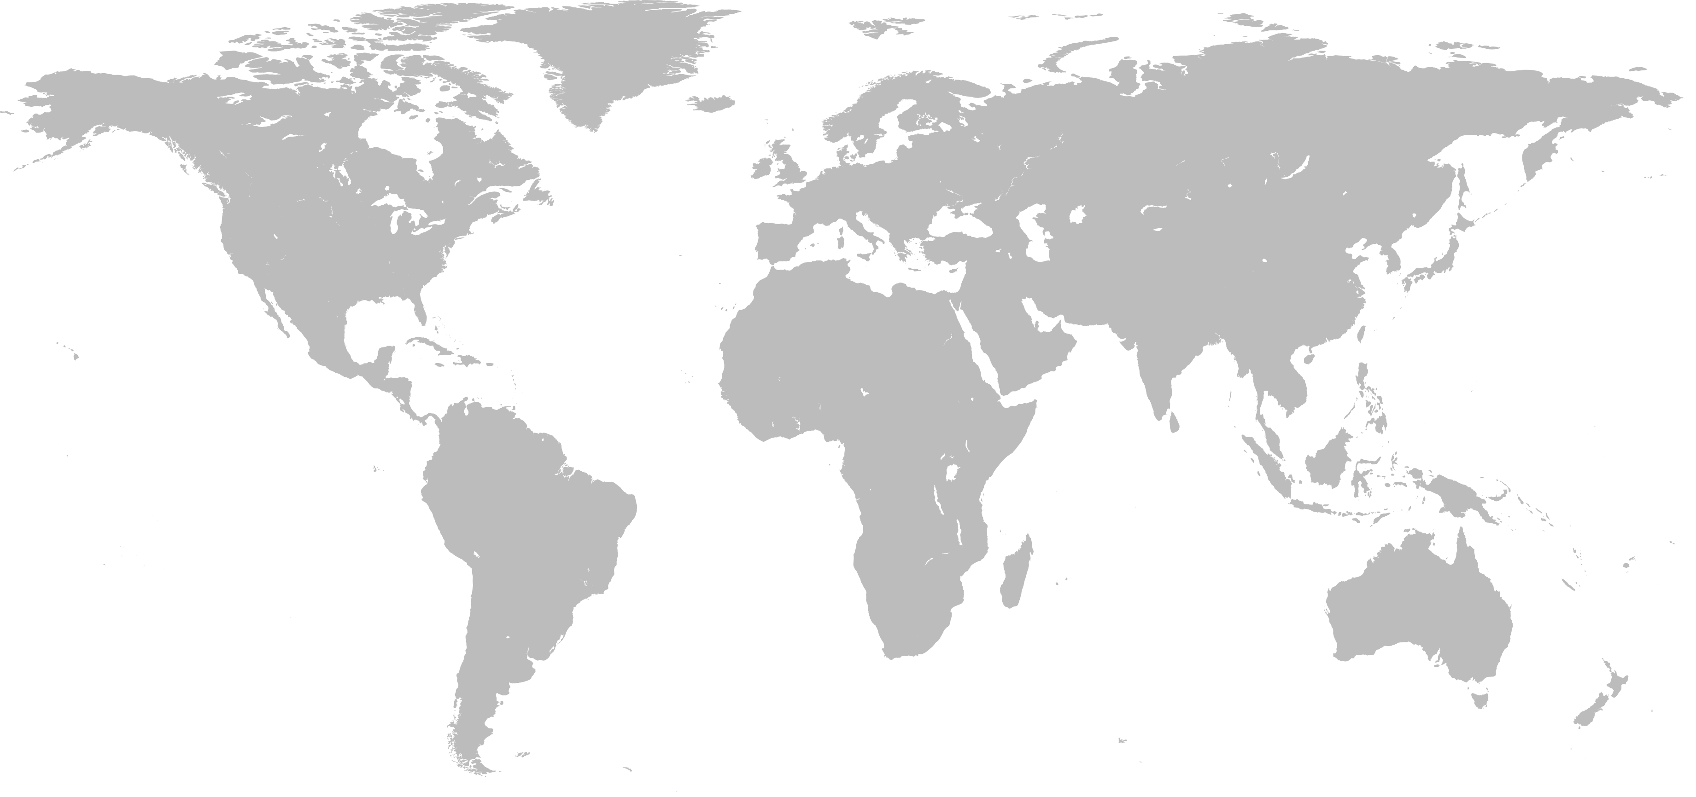

WHERE IN THE WORLD?

Slide 10
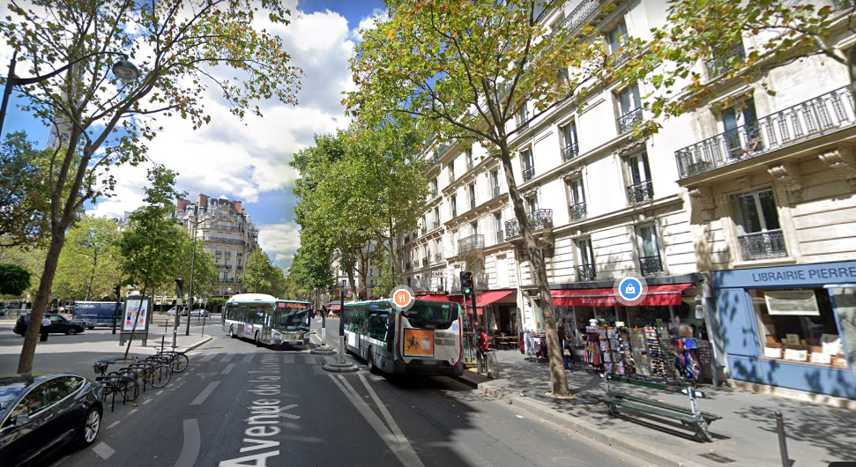

Slide 11
WHERE IN THE WORLD?
DRAW AN ‘X’ ON THE MAP FOR YOUR GUESS

Slide 12
WHERE IN THE WORLD?
ANSWER – PARIS, FRANCE

Slide 13
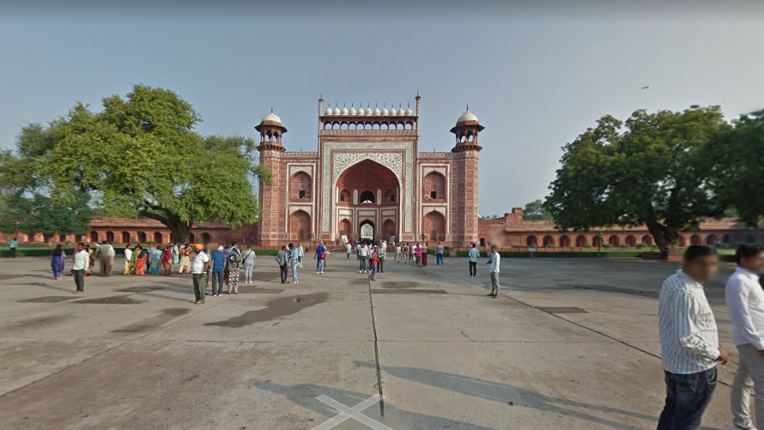

Slide 14
WHERE IN THE WORLD?
DRAW AN ‘X’ ON THE MAP FOR YOUR GUESS

Slide 15
WHERE IN THE WORLD?
ANSWER – TAJ MAHAL, INDIA

Slide 16
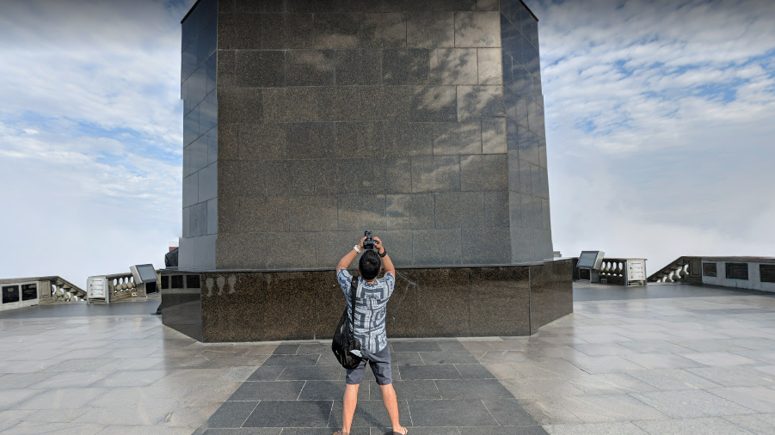

Slide 17
WHERE IN THE WORLD?
DRAW AN ‘X’ ON THE MAP FOR YOUR GUESS

Slide 18
WHERE IN THE WORLD?
ANSWER – CHRIST THE REDEEMER STATUE, RIO DE JANEIRO, BRAZIL

Slide 19
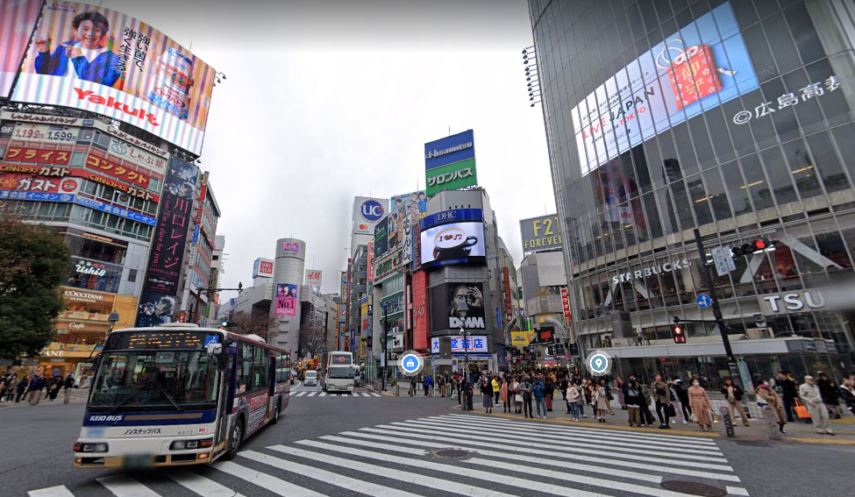

Slide 20
WHERE IN THE WORLD?
DRAW AN ‘X’ ON THE MAP FOR YOUR GUESS

Slide 21
WHERE IN THE WORLD?
ANSWER – TOKYO, JAPAN

Slide 22
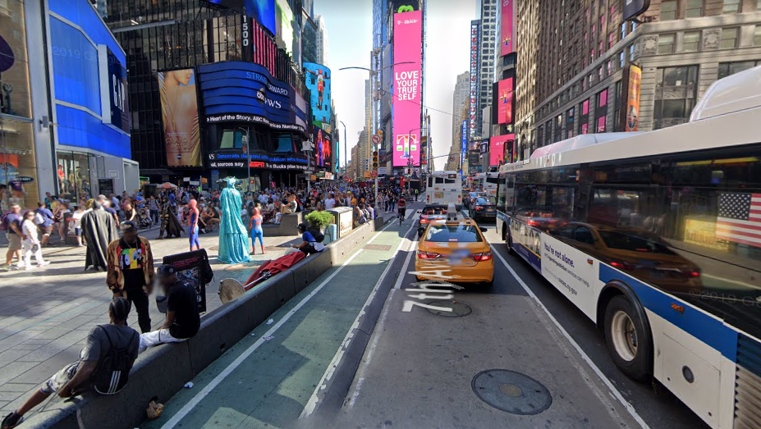

Slide 23
WHERE IN THE WORLD?
DRAW AN ‘X’ ON THE MAP FOR YOUR GUESS

Slide 24
WHERE IN THE WORLD?
ANSWER – NEW YORK, USA

Slide 25
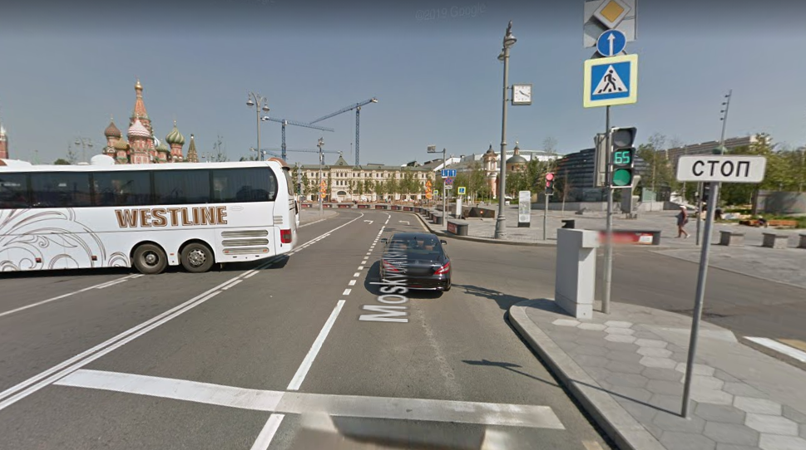

Slide 26
WHERE IN THE WORLD?
DRAW AN ‘X’ ON THE MAP FOR YOUR GUESS

Slide 27
WHERE IN THE WORLD?
ANSWER – MOSCOW, RUSSIA

Slide 28
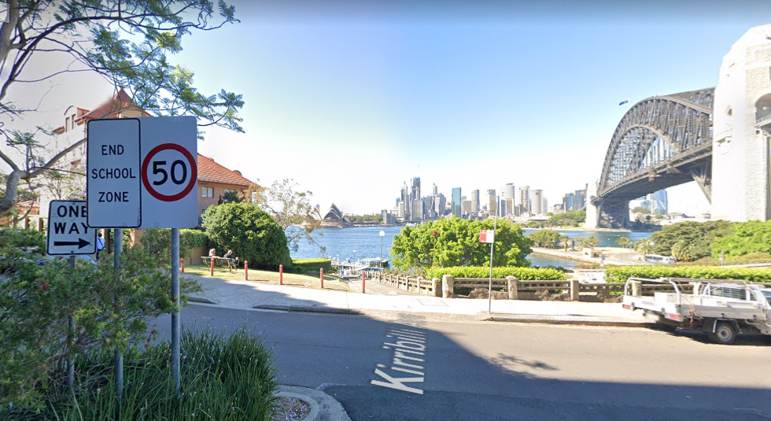

Slide 29
WHERE IN THE WORLD?
DRAW AN ‘X’ ON THE MAP FOR YOUR GUESS

Slide 30
WHERE IN THE WORLD?
ANSWER – SYDNEY, AUSTRALIA

Slide 31
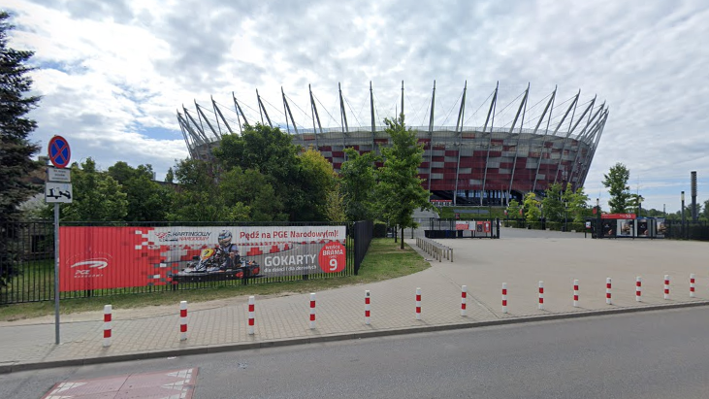

Slide 32
WHERE IN THE WORLD?
DRAW AN ‘X’ ON THE MAP FOR YOUR GUESS

Slide 33
WHERE IN THE WORLD?
ANSWER – WARSAW, POLAND

Slide 34
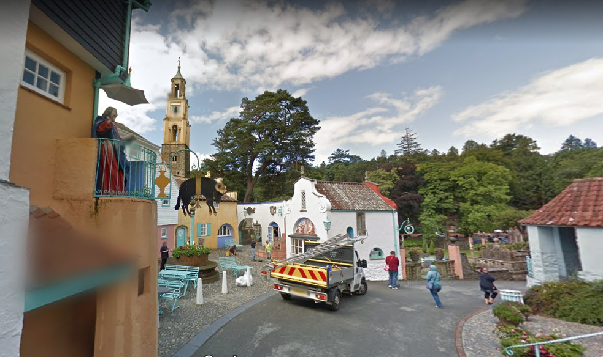

Slide 35
WHERE IN THE WORLD?
DRAW AN ‘X’ ON THE MAP FOR YOUR GUESS

Slide 36
WHERE IN THE WORLD?
ANSWER – PORTMEIRION, WALES, UK

Slide 38


Slide 40

This week’s challenge . . .

Slide 41
Next week . . .
Add a preview for next week’s activity here!

