Slide 1
Juniors Week 2 Taster Programme
_________________________________________________________
If you have not already downloaded and installed the Brigade fonts used in this presentation you can download our font pack at
http://leaders.boys-brigade.org.uk/ourbrand.htm
Alternatively you may just need to check through the presentation to ensure the substitute font used is displaying correctly.
_________________________________________________________
All elements of the programme that need to be shown on screen are included in this presentation. Please remove any elements you do not need. This PowerPoint presentation will have any videos mentioned in the programme embedded into it. When you come to these click the play button to start the video. Ensure when sharing your screen through Zoom you tick the ‘Share Computer Sound’ box.
_________________________________________________________
Please check through and edit text as required. Rember to remind parents / carers to send in photos of their child taking part in the ‘Takeaway Challenge’ and add these in on the ‘Last week’s challenge’ slide. The young people will love seeing themselves here ☺
A template points chart is also included which you can update each week and share as part of your virtual session.

Slide 2


Slide 3

Last week’s challenge . . .
Add photos sent in by parents/carers here!

Slide 4

Remember to share your photos with us
Send by email to xxxxxxx or via WhatsApp/SMS/Social Media

Slide 5
#BBatHOME Points Chart
Copy and paste your latest points chart from the previous week here
We will update points each week and share on our Virtual Sessions!
Medals will be awarded as follows:
Bronze = 10+ Points / Silver = 20+ Points / Gold = 35+ Points / Diamond = 50+ Points / Platinum = 75+ Points

Slide 7


Slide 8


Slide 9
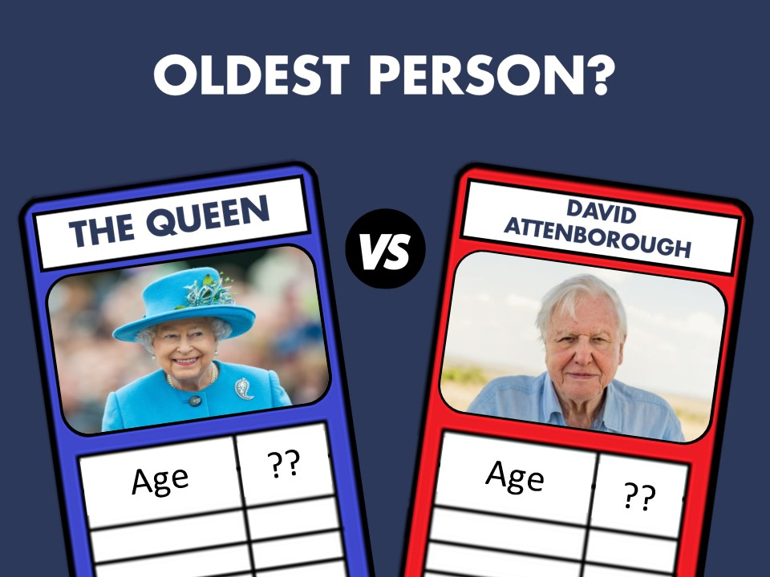

Slide 10


Slide 11


Slide 12


Slide 13
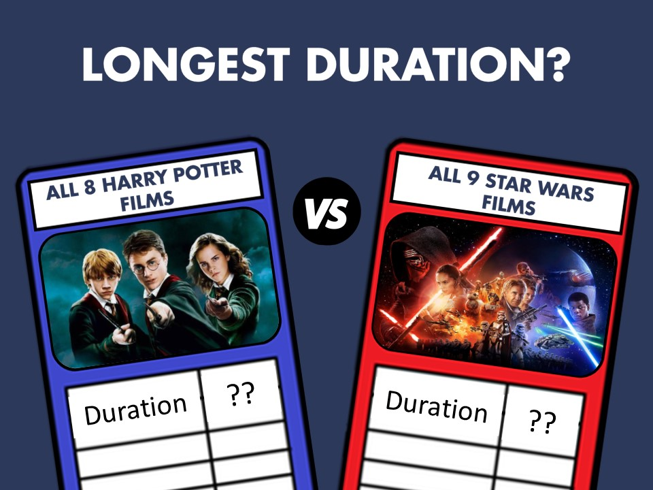

Slide 14
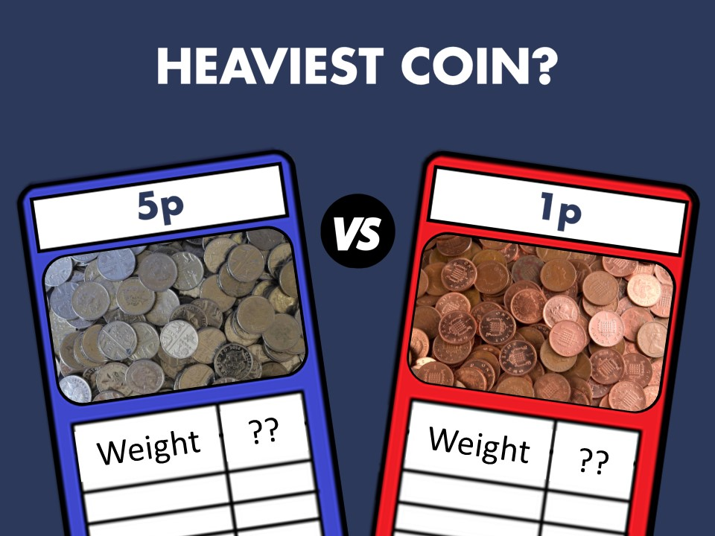

Slide 15
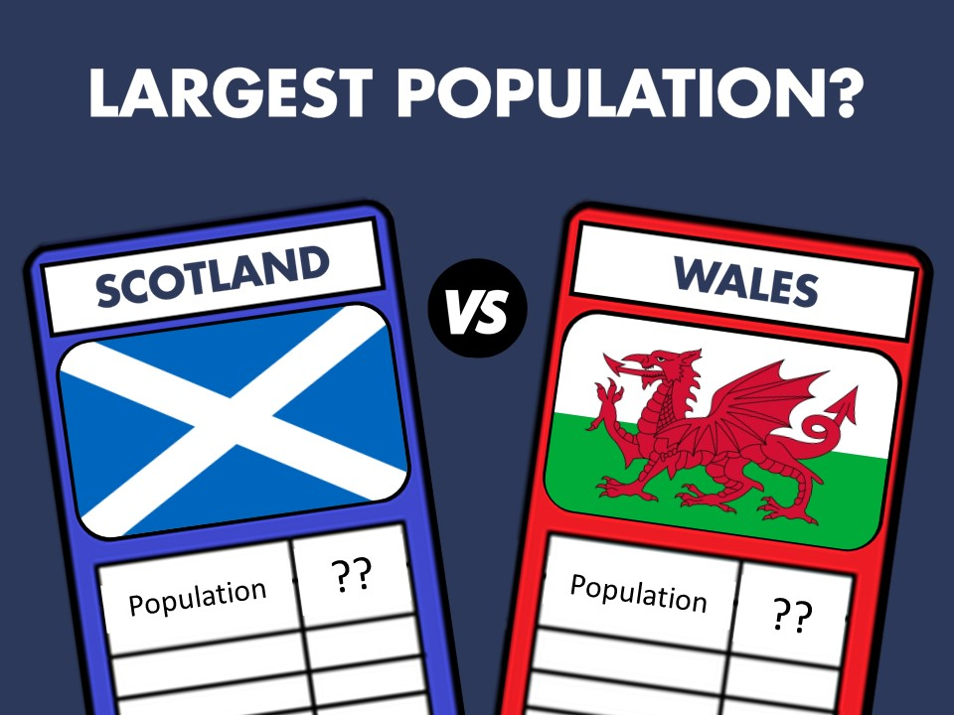

Slide 16


Slide 17
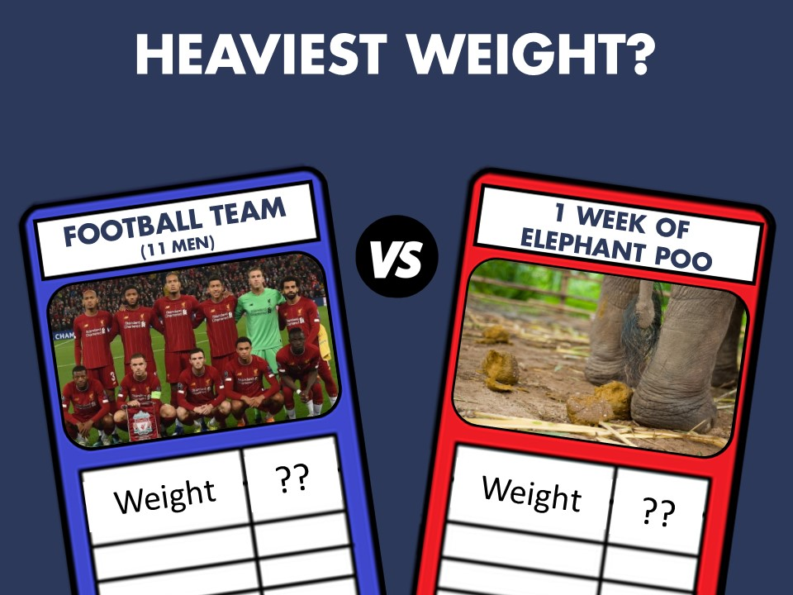

Slide 18
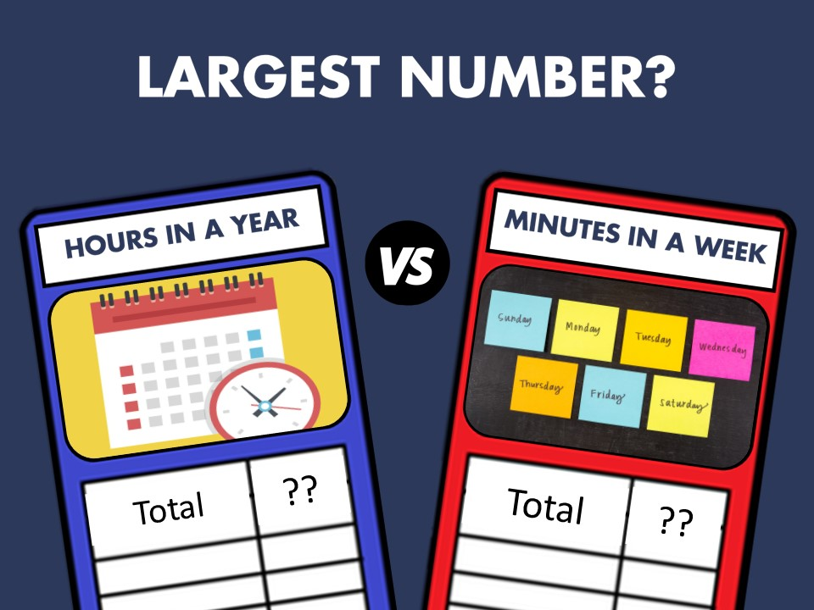

Slide 19


Slide 21
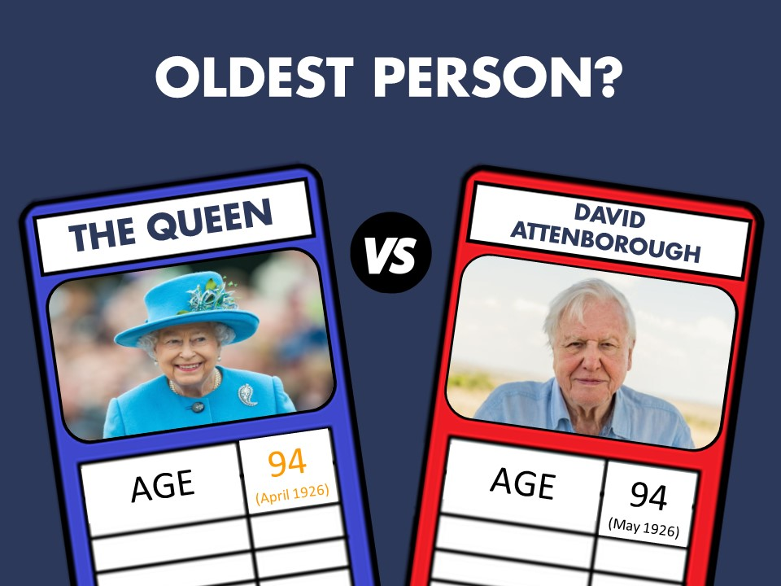

Slide 23


Slide 25


Slide 27


Slide 29
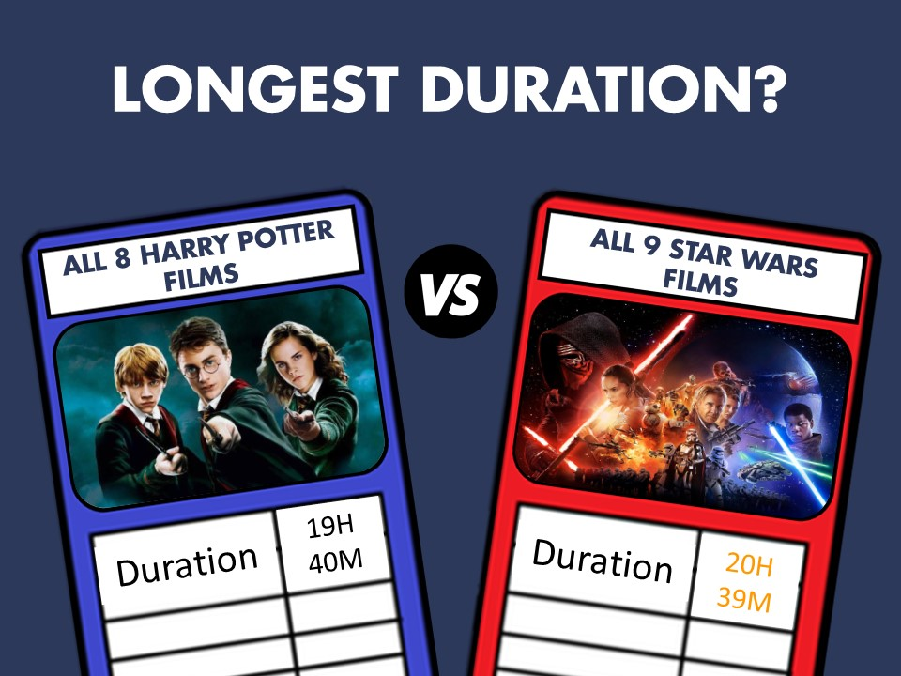

Slide 31


Slide 33


Slide 35


Slide 37


Slide 39
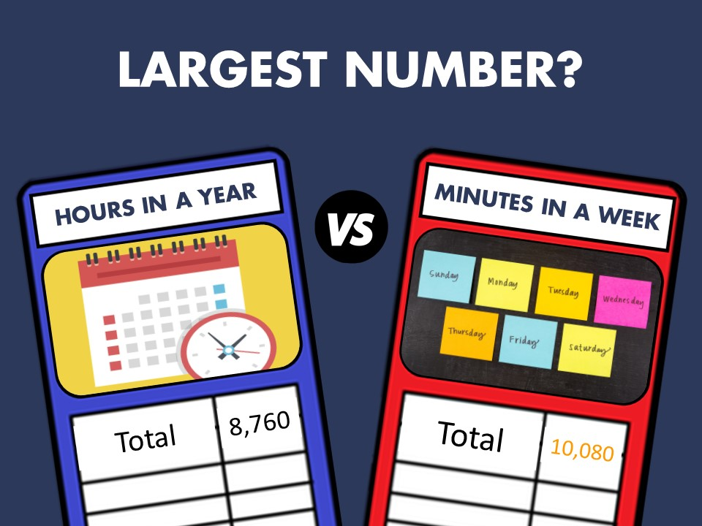

Slide 41


Slide 43
Tray Memory
Game

Slide 44


Slide 45
2 ITEMS WILL BE REMOVED
CAN YOU TELL WHICH ITEMS ARE MISSING?
(Stay on this screen for 10 seconds)

Slide 46



Slide 47


THESE WERE THE MISSING ITEMS

Slide 49
2 ITEMS WILL BE REMOVED
CAN YOU TELL WHICH ITEMS ARE MISSING?
(Stay on this screen for 10 seconds)

Slide 50


Slide 51


THESE WERE THE MISSING ITEMS

Slide 53
2 ITEMS WILL BE REMOVED
CAN YOU TELL WHICH ITEMS ARE MISSING?
(Stay on this screen for 10 seconds)

Slide 54


Slide 55


THESE WERE THE MISSING ITEMS

Slide 57
2 ITEMS WILL BE REMOVED
CAN YOU TELL WHICH ITEMS ARE MISSING?
(Stay on this screen for 10 seconds)

Slide 58


Slide 59


THESE WERE THE MISSING ITEMS

Slide 60
One final look
at the tray . . .

Slide 62
CAN YOU REMEMBER ALL 20 OBJECTS ON THE TRAY?

Slide 63
Pen
Pencil
Paintbrush
Apple
Key
Highlighter
Spoon
Sweet
Lightbulb
£2 Coin
Peg
Screwdriver
Battery
Plaster
1p Coin
Clock
Juniors Badge
Scissors
Screw
Rubber

Slide 65

This week’s challenge . . .

Slide 66

Next week . . .
SUPERHEROES

